Slide 1
Advanced petrology: kinetic theory in petrology
Course: 650.810
6-lecture: Diffusion-historical background

Slide 2
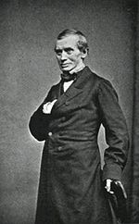
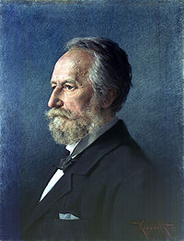
The first experimental study of diffusion was performed
by Thomas Graham. He studied diffusion in gases and
the main phenomenon was described by him in 1831-1833
In 1855, Adolf Fick, the 26-year old anatomy demonstrator from
Zürich proposed his law of diffusion. He used Graham's research
and his goal was "the development of a fundamental law, for the
operation of diffusion in a single element of space".
Fick's law: the most important law
in the next lectures

Slide 3
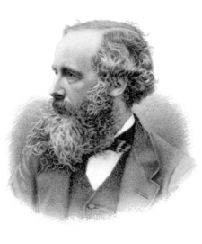
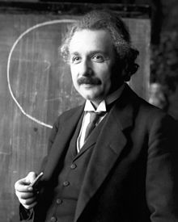
In 1858, James Clerk Maxwell developed the first
atomistic theory of transport processes in gases.
The modern atomistic theory of diffusion and
Brownian motion was developed by Albert Einstein
and others.

Slide 4
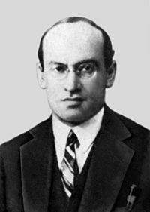
Yakov Frenkel (or, sometimes, Jakov or Jacov) proposed
in 1926 and then elaborated the idea of diffusion in
crystals through local defects (vacancies and interstitial
atoms). He introduced several mechanisms of diffusion
and found rate constants from experimental data. Later,
Nowadays, it is universally recognized that atomic defects
are necessary to mediate diffusion in crystals

Slide 5
Why diffusion??
The diffusion is an important process in a wide variety of materials processes as well in
Earth sciences. For example, the production of different types of steel depends on the
diffusion of carbon atoms into iron metal. The movement of mass as well as heat above
100 km in the atmosphere is also controlled by diffuion.
The chemical changes both beteen minerals and in the overall bulk composition due to
metasomatism and metamorphic processes rely heavily on diffusion in solution, within
minerals and along mineral interfaces.
Diffusion in solution plays a great part in the diagenetic changes undergone by sediments.
Crystal growth in magma chambers relies on diffusion of chemical components in the melt.
Resetting of ages in geochronology often depends on the diffusion of radiogenic daughters.
Diffusion creep is one of the important mechanisms for movement in the Earth's mantle.
Random walk

Slide 6
Fick's first law:
The First step is to relate a given flux with a given driving force.
Flux of a component A (JA) is defined as the quantity of A passing through a unit area
of a well-defined reference surfaceduring unit time.
Flux of heat during conduction (JQ) is defined as the amount of heat passing through
a unit area of a well-defined reference surfaceduring unit time.
JQ = - K (δT / δx)
K is the thermal conductivity
Fourier law (1922)

Slide 7
Fick's first law:
In 1955 Fick proposed his first law which takes the same form of the Fourier law
JA = - DA (δCA / δx)
CA is the concentration of A. DA diffusion coefficient.
Unit of DA is unit area / unit time.
Why is the “-“ sing?

Slide 8
Fick law will not work here due the singularity of δCA / δx
CA
Phase I
Phase II
Concentration gradient
X
µA
Phase I
Phase II
Chemical potential gradient
This is all avoided by use of δµA / δx
At the equilibrium point µA of phaseI = µA of phaseII
X

Slide 9
Fick's first law:
JA = - DA (δCA / δx)
CA is the concentration of A. DA diffusion coefficient.
JA = - LA (δµA / δx)
LA is the phenomenological coefficient.

Slide 10
Mobility (UA):
The mobility is definrd as the limiting velocity attained by a particle per unit force.
Velocity = UA FA
UA is the mobility of the particle A. FA is the total force.
Recalling that a flux obtain from the product of a velocity and a concentration.
Flux = CA UA FA
FA = - (δµA / δx)
JA = - CA UA (δµA / δx) = - LA (δµA / δx)
LA (the phenomenological coefficient) = CA UA .

Slide 11
Limiting Mobility (UA ):
0
In case that the particle A is a tracer component in the fluid or solid medium.
The mobility becomes the limiting mobility (UA ), and the chemical potential is given by
By the ideal thermodynamic limit:
0
µA = µA + RT ln CA
δµA / δx = (RT/CA) (δCA / δX)
JA = - CA UA (δµA / δx) = - RTUA (δCA / δx)
Back to the original Fick law
JA = - DA (δCA / δx) = - RTUA (δCA / δx)
0
DA = RTUA
0
Nernst-Einstein relation used to
extract mobilities from tracer
diffusion experiment.
0
DA is the tracer diffusion coefficient

