Slide 1
M.Sc. thesis writing course:
Tips to find your way
Tamer Abu-Alam
UiT The Arctic University of Norway
Tamer.abu-alam@uit.no
www.abualam.info

Slide 2
Course information and materials are here:
http://abualam.info/thesis_writing/
Department of Geosciences, University of Tromsø – The Arctic University of Norway November 13, 2019

Slide 3
Pre-course survey
http://abualam.info/thesis_writing/
Please take 5 minutes to fill out the survey
Department of Geosciences, University of Tromsø – The Arctic University of Norway November 13, 2019

Slide 4
Why scientific writing?
Scientists write to communicate their research results and findings with other scientists or experts. In this way, information is shared in a systematic manner, so that researchers can build upon the work of others.
There are different ways to share information amongst the scientific community, such as oral or poster presentations on scientific conferences, written reports, peer reviewed papers.
Writing master and PhD theses are also scientific writing.
Although these different ways of scientific writing have different shapes, all of them have a similar structure !!!
Department of Geosciences, University of Tromsø – The Arctic University of Norway November 13, 2019

Slide 5

Why scientific writing?
Start your higher academic education
(importance vs. difficulties)
Department of Geosciences, University of Tromsø – The Arctic University of Norway November 13, 2019

Slide 6
Research problem/
question
Research hypotheses
Methods to test the hypotheses
Data collected from different methods
Data discussion
Hypotheses discussion
Conclusion/
giving answer of
your research
question
Department of Geosciences, University of Tromsø – The Arctic University of Norway November 13, 2019

Slide 7
Who of you did not start his/her master project yet? Or did not choose his/her supervisor and his/her subject?
Department of Geosciences, University of Tromsø – The Arctic University of Norway November 13, 2019

Slide 8
How should I start my master program??
Since this can be one of the most important steps of your career
Choose right
What you like most
What can help you in the future
Think well before you start
Choose the subject
Choose the research point
Two way to start
https://uit.no/om/enhet/artikkel?p_document_id=379758&p_dimension_id=88137&men=28714
Institutt for geovitenskap webpage / Utdanning / Tilgjengelige masteroppgaver
Or
Go direct to a supervisor
Department of Geosciences, University of Tromsø – The Arctic University of Norway November 13, 2019

Slide 9
Supervision contract / proposal / project
Title
Aims
Methods (e.g. field work)
Time plan
Number of courses needed to finish the master program
Example:
abualam.info/wp-content/uploads/2019/04/supervision_contract.pdf
The proposal should be submitted at least one year before submitting the Master thesis
If you aim to submit the thesis on 15 May 2019, the proposal should be ready by 15 May 2018
Department of Geosciences, University of Tromsø – The Arctic University of Norway November 13, 2019

Slide 10
Research problem/
question
Research hypotheses
Methods to test the hypotheses
Data collected from different methods
Data discussion
Hypotheses discussion
Conclusion/
giving answer of
your research
question
Department of Geosciences, University of Tromsø – The Arctic University of Norway November 13, 2019

Slide 11
Examples
Research problem/
question
Research hypotheses
Methods to test the hypotheses
Data collected from different methods
Data discussion
Hypotheses discussion
Conclusion/
giving answer of
your research
question
Department of Geosciences, University of Tromsø – The Arctic University of Norway November 13, 2019

Slide 12
Thesis structure
Abstract
Research problem/
question
Introduction
Research hypotheses
Methods section
Methods to test the hypotheses
Data presentation section
Data collected from different methods
Data discussion
Discussion section
Hypotheses discussion
Conclusion/
giving answer of
your research
question
Conclusion
Acknowledgment
Reference list

Slide 13
When should a researcher/a student/a scientist start writing?
While he/she
still working on
research hypotheses
and data
collections
After getting
his/her
conclusion
Department of Geosciences, University of Tromsø – The Arctic University of Norway November 13, 2019

Slide 14
When should a researcher/a student/a scientist start writing?
Write while you still working on research hypotheses and data collections
Write using any language
Do not care at this stage about the grammar and text structure
Just write and transfer your ideas to a text
The writing process may change the research question and/or the conclusion. So the writing process can be considered as part of the scientific thinking
Between the preparing of the master project until the submission ----
work closely with your supervisor
These help to avoid the stress
Department of Geosciences, University of Tromsø – The Arctic University of Norway November 13, 2019

Slide 15
Thesis structure
Abstract
Research problem/
question
Introduction
Research hypotheses
Methods section
Methods to test the hypotheses
Data presentation section
Data collected from different methods
Data discussion
Discussion section
Hypotheses discussion
Conclusion/
giving answer of
your research
question
Conclusion
Acknowledgment
Reference list

Slide 16
How to write a solid thesis
First draft
Second draft
Semi Final
Final
Title page
Acknowledgment
Abstract
Table of contents
List of figures
List of tables
Introduction
Literature review
Methods
Results
Data interpretation
Discussion
Conclusions
References list
Appendix
Abstract
Introduction
Literature review
Methods
Results
Data interpretation
Discussion
Conclusions
Introduction
Literature review
Methods
Results
Data interpretation
Discussion
Conclusions
Department of Geosciences, University of Tromsø – The Arctic University of Norway November 13, 2019

Slide 17
Preparing your figures
Use a suitable graphic editor / e.g. CorelDRAW; Adobe Illustrator
Convert all the figures to vector format
High resolution / small size
Aspect Ratio
The font size should be readable e.g. >6, better 8 or 9
Better Arial font
Be consistent (the same font - the same size)
Better the same colour scheme
The best way to insert the vector figures to the thesis as PDF file or as eps file
Field and microscopic photos -- try different format until you get the highest resolution
with the smallest size (JPEG files)
Make sure the axes are labelled and the labels explained in the caption.
Print your final figures before the submission to check the quality
Visual check of the final PDF file of the thesis
Department of Geosciences, University of Tromsø – The Arctic University of Norway November 13, 2019

Slide 18
Preparing your figures
Maps: On maps, all labelled locations should be used in the text somewhere and vice versa. In fact, it
is even more important that all geographic locations mentioned in text are to be found somewhere
on your map.
Define all the symbols, rock unit colours that you use on your figures
Department of Geosciences, University of Tromsø – The Arctic University of Norway November 13, 2019

Slide 19
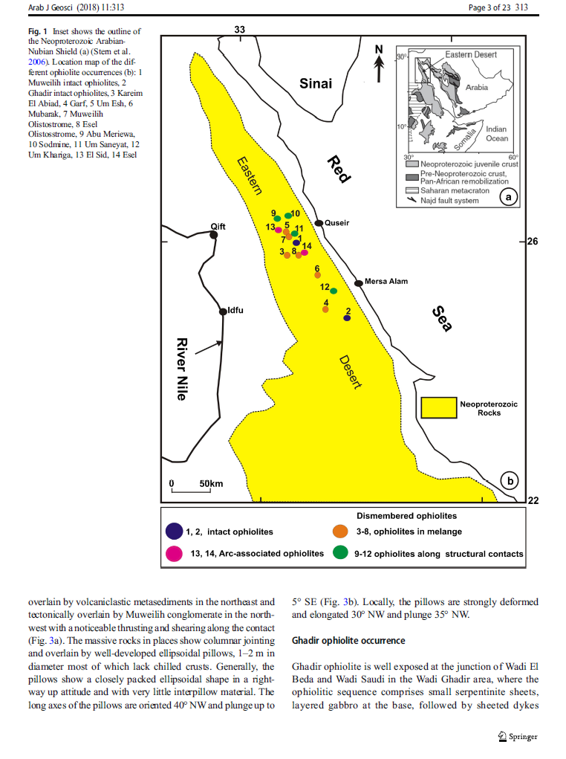
Example of bad figures. Large figure,
very small font-size, no detail
Department of Geosciences, University of Tromsø – The Arctic University of Norway November 13, 2019

Slide 20
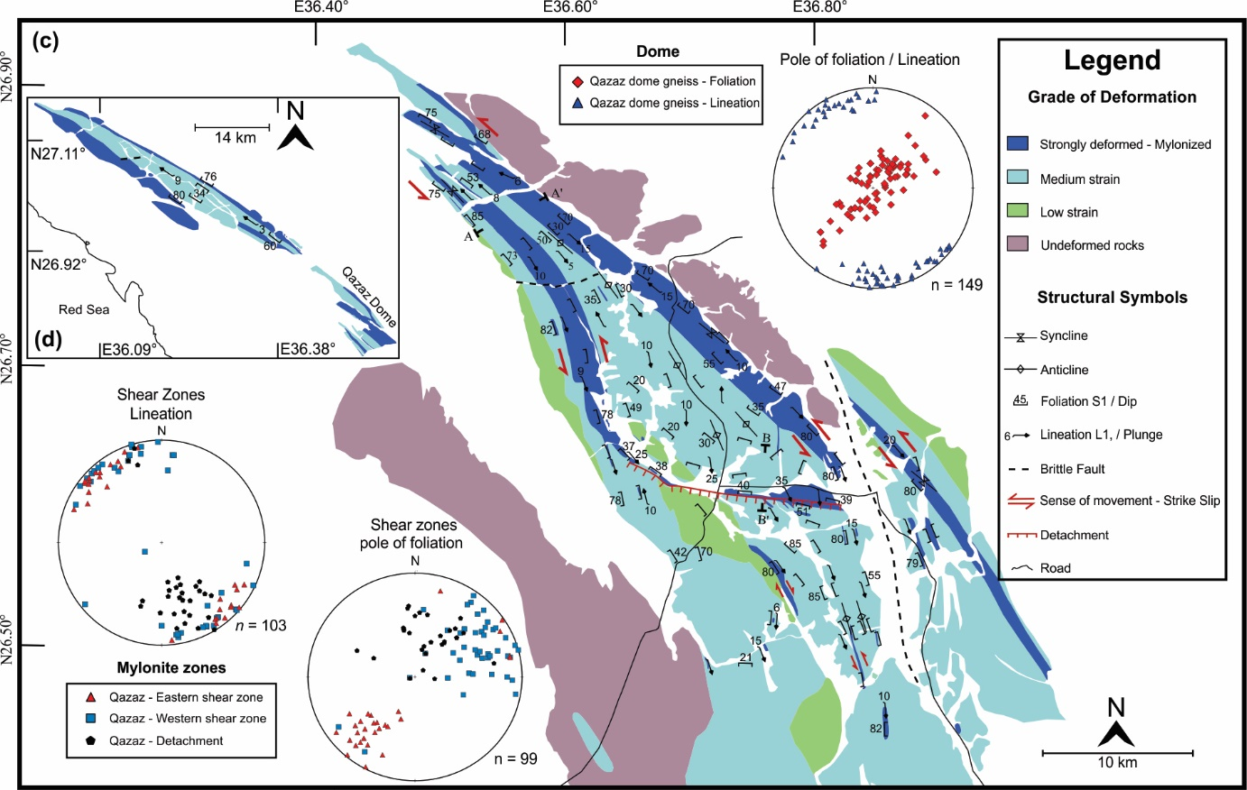
Example of good figures:
Nice color – large font-size
More information
Department of Geosciences, University of Tromsø – The Arctic University of Norway November 13, 2019

Slide 21
Preparing your Tables
Better to re-edit the tables on a word process instead of use it direct from excel
The font size should be readable e.g. >6, better 8 or 9
Be consistent (the same font - the same size)
In chemistry: there is no value called “0” – best to use b.d.l (below detection limit)
Print your final tables before the submission to check the quality
Visual check of the final PDF file of the thesis
Department of Geosciences, University of Tromsø – The Arctic University of Norway November 13, 2019

Slide 22
Introduction section
Highlight the research problem.
This is the part where you capture your readership. If you haven’t gotten to the reason why your thesis
should be of interest to anybody by the third line – then you have lost.
So don’t fall into the trap starting with “My study area is located at latitude xyz longitude xyz”. If you
almost DID start your manuscript like this – think again: Is there really no better reason why you did
all your work than to collect new data for region xyz ? What about: “Region xyz is the missing link to
explain the tectonic evolution of the Alps because....? You can then continue with: “In order to solve
this problem I have studied.....”.
Even if you are publishing a (seemingly boring) taxonomic study of foraminifera, there will be
(hopefully) a larger picture why it is essential to collect this data for understanding planet Earth.
You can add a last paragraph of the introduction section to summarize the methods that you used
and the major conclusion.
Each paragraph has only one message
Department of Geosciences, University of Tromsø – The Arctic University of Norway November 13, 2019

Slide 23
Geological setting
Data presentation / previous work
In Earth science thesis, there is typically the “geological setting” section. From the philosophical point
of view this section is really a part of the introduction, so it can be a subsection of the introduction, or
a section of its own. For some thesis you may not need such a section at all (depending on the theme
and scope of your thesis). If you do feel you need one, then keep in mind that you can’t keep the
reader forever from your own work and really need to tell him or her only the essence necessary
to understand the later conclusion of your thesis. The length of the geological setting section very
much depends on how much info you feel the reader needs in order to focus onto your problem.
The maps, your field work and field photos should be cited here (except if your work is heavily depend
on field data e.g. structural geology).
Department of Geosciences, University of Tromsø – The Arctic University of Norway November 13, 2019

Slide 24
Methodology section
If your manuscript contains analyses made with some complicated machine like an electron
microprobe or a mass spectrometer, then list the model type of the machine and the most important
machine specifics (acceleration voltage, beam diameter, machine manufacturer etc.). Also do not forget
to list where you did the analyses (which institute, university).
In numerical modelling studies, describe the code you used, the software and the origin of digital
data sets (if you used any). In some cases it would be necessary to write something about the methods
of preparation and preservation here.
In this section also list the means for determination you use, the error of each method
Also, you may want to use this section to explain what acronyms you use (abbreviation that will be used).
Do not forget each method should be presented in a separated paragraph
Department of Geosciences, University of Tromsø – The Arctic University of Norway November 13, 2019

Slide 25
Data presentation:
Data section: In the data section you describe what you found. The most common mistake people
make in this section is that they mix data and interpretation. Never write something like: “Garnets
grew syntectonically” and not even: “Garnets contain spiral shaped inclusion trails and are therefore
interpreted to have grown syn-tectonically”. Simply write: “Garnets contain spiral inclusion trails”
and keep the interpretation that this means syntectonic growth for the “interpretation” section of
your manuscript. Try to be as descriptive as you can.
Each method in the methodology section should produce data that will be discussed here
In separated paragraphs or even separated sub-sections
Sometime (only sometime) you need some data interpretation to explain why you used the following
methods
For example the optical microscope is not enough to distinguish between different minerals,
therefore you will use XRD to identify these minerals
In this case, you can add an interpretation paragraph to the end of the sub-section
Department of Geosciences, University of Tromsø – The Arctic University of Norway November 13, 2019

Slide 26
Data Interpretation:
This is the section in which you interpret your data. It is where you define a PT path from the mineral
chemistry and petrography or it is the place where you infer a sequence of deformation events from
superposition of fabrics described earlier. Try to avoid wide reaching interpretations and keep
those until later and focus on the direct interpretation of the observations.
Use good and clear diagrams and figures to present the relation between your data.
Department of Geosciences, University of Tromsø – The Arctic University of Norway November 13, 2019

Slide 27
Discussion:
This is the section where you discuss the wider implications of your interpretation based on previous
Ideas/work. Sticking to the examples from above, you can discuss here what your derived PT path
means for the tectonic evolution of your area or how you interpret your deformation sequence in
terms of a stress regime. This is also the place where you can question your own interpretation and
discuss what alternative interpretations of your data are possible, what the error bars on your
interpreted results are and so on.
Make your life easy – divide the discussion section to subsections
Department of Geosciences, University of Tromsø – The Arctic University of Norway November 13, 2019

Slide 28
Conclusion:
Conclusion is useful summary of your finding.
The one-sentence-justification of your work that you may want to have in the abstract is – of course –
not necessary here. A useful sentence I often start the conclusion section with (but not obligatory) is:
“In summary from above, we draw the following conclusions from this study: .....”
The conclusion can have different title e.g. tectonic model
Department of Geosciences, University of Tromsø – The Arctic University of Norway November 13, 2019

Slide 29
Abstract/Summary
The last part to be written in the thesis
The Abstract is actually not unlike the conclusion section of your thesis, complemented with a
“condensed” introduction section. In fact, it should summarise your entire thesis in less than 1 page.
The style of the abstract deviates from the remainder of the manuscript in as much as it is uncommon
to list references (unless a given reference is at the heart of subject of your manuscript) and no
abbreviations or acronyms. Everything else should be in the same style as the remainder of the thesis.
With respect to its content, the abstract should have three parts.
First part of abstract (the research problem): One or two sentences justifying what you did. For example:
“Life on Mars has intrigued many scientists over the years. Here we report of the first conclusive proof ...”
Don’t make this justification too long! Many authors confuse the abstract with an introduction to their work.
All your findings need to be mentioned in the abstract in an abbreviated form. In fact, if the relevance of your
findings is self evident, then you can leave any introductory sentence justifying what your did off all together.
Second part of abstract: The next 2–10 sentences should explain what you did and what the results of your
analysis are. For example: “In our study we analysed rocks from Mars for organic compounds and found
embryos of little green men. Isotope analysis shows that these compounds are made of Helium nuclei ...”
Third part of abstract: The end of the abstract is a 1–2 sentence conclusion and/or possibly
an interpretation for the wider reaching implications. for example: “We conclude that life on
Mars is possible after all. Our conclusion supports the idea of NASA to settle people there before
too long.”
Department of Geosciences, University of Tromsø – The Arctic University of Norway November 13, 2019

Slide 30
Acknowledgements
This is the section where the reader learns who has contributed to the thesis. Supervisor, field assistants or
laboratories who provided analyses are typical candidates for acknowledgements. Funding institutions
and project numbers usually should be listed too.
Department of Geosciences, University of Tromsø – The Arctic University of Norway November 13, 2019

Slide 31
The Reference List
Use a consistent reference style in the reference list. Below are some examples.
Your supervisor reading your thesis, will jump at you if you have not followed your chosen style
consistently throughout your manuscript.
Alley, R.B., Cuffey, K.M., Evenson, E.B., Strasser, J.C., Lawson, D.E., Larson, G.J., 1997. How glaciers
entrain and transport basal sediment: Physical constraints. Quaternary Science Reviews 16, 1017-1038.
References should be listed alphabetically in the reference list: When there is several papers with the
same first author, then his single authored papers go first, then the double authored ones, then his/her
“et al.” papers. Within each of these go by year (if there are several “Smith and Wesson” papers. If
there is more than 1 paper by the same authors in the same year, then use “a” and “b” where “a” is for
the paper that cited first in the text of your manuscript (e.g. Smith and Wesson, 2000a).
When citing books, you usually need to list the publishers and the total page number of the book.
For example:
Smith A., Wesson P., 2000. Encyclopedia of Barbie Dolls. Springer Publishers, 270 p.
Department of Geosciences, University of Tromsø – The Arctic University of Norway November 13, 2019

Slide 32
The Reference List
When citing articles that have appeared in edited books, then you need to list the editors and both the
title of the article you want to cite together with the title of the book it appeared in:
Andreassen, K., Ødegaard, C.M., Rafaelsen, B., 2007. Imprints of former ice streams, imaged and
interpreted using industry three-dimensional seismic data from the south-western Barents Sea,
In: Davies, R.J., Posamentier, H.W., Wood, L.J., Cartwright, J.A. (Eds.), Seismic Geomorphology:
Applications to Hydrocarbon Exploration and Production. Geological Society, Special Publications,
London, pp. 151-169.
Use DOI numbers as you can in your reference list
Department of Geosciences, University of Tromsø – The Arctic University of Norway November 13, 2019

Slide 33
Thesis text
Uniform style: Make sure that the entire manuscript is in the same font, has the same page margins,
has the same line spacing etc.
Abbreviations: There are some common abbreviations like T for temperature, P for pressure.
Use those if there is a common abbreviation. Don’t forget to explain each variable the first time
you use it in the text even if it is a common one.
SI units: Try to stick to the SI units (seconds s, meters m, joules J, kilogram kg and the derived units
Pa for pressure, N for Newton and so on). Some common deviations from the use of SI units in
geology are the use of “my” for “million years” (1 my = 3.15 x 1013 s) and “kbar” for pressure.
It’s fine to use these as they are deeply entrenched in the literature, but if you do – be consistent
(i.e. don’t mix the use of seconds with million years in one manuscript).
Million Year: This may be “my”, “Ma” or “m.y.” If there is nothing prescribed, then I suggest to use “my”
for a duration (e.g. “Metamorphism lasted for 80 my during the Paleozoic”) and “Ma” if you mean a
time in the past (e.g. “Metamorphism occurred 80 Ma ago in the Cretaceous.
Department of Geosciences, University of Tromsø – The Arctic University of Norway November 13, 2019

Slide 34
Thesis text
Variables: Mathematical variables should always be in italics, but units not! So: “s” means seconds
without explanation, but “s” is a variable that needs to be defined.
Use few variables: If you define a variable or other abbreviation that is only used a handful of times
in the entire manuscript, you should consider to rather write it out instead. As soon as you
introduce a variable the reader needs to remember what it means every time it occurs. So if there
are only few occurrences, no need to introduce it in the first place.
Numbering of equations: Equations should be numbered consecutively and used by citing “eq. 7”
or: “equation 7” or: “eq. (7)” or something like this in the text. To offset equations from text, simply
insert a paragraph break or even an extra line.
Equations are part of the text: Remember that equations may occur in mid sentence. Whether a comma
or a colon follows an equation, or whether you start with a capital or not in the next line depends on
the sentence (even if it is in a separate line, the sentence goes on).
Department of Geosciences, University of Tromsø – The Arctic University of Norway November 13, 2019

Slide 35
Thesis text
Writing out numbers: Make a decision on writing out numbers or not. Often it is best to write out the
numbers from one to ten, but write them in digits for larger numbers, i.e. its “nine my”, but: “90 my”.
Also be careful with comma and dot. In German a comma is used to indicate where the decimals start.
In English a comma is used to separate every 3 orders of magnitude. That is: “10,000” in English means
ten thousand. “10,000” in German means ten point zero, zero, zero, i.e. ten accurate to three digits.
Latitude and longitude, compass directions: Writing out latitude and longitude in degrees, minutes and
seconds or in degrees and decimal degrees is both possible (i.e. 36° 30’ 00’’ = 36.5000°), but be
consistent. The use of north, east, south and west or N, S, E, W is similar. Make a decision on what you
want to use and be consistent. Don’t forget to explain your reference system (e.g. WGS84) in the
methods section!
References: At all stages of the manuscript writing, your manuscript should have a reference list that
matches the citations in the draft of the text. That is: all text that you have written already should be
cross referenced and be accompanied by a corresponding reference list. If your manuscript is still in
the early stages, some references may fall out later again (and in this case you have typed it in for
nothing), but references are such an integral part of scientific writing, that it is only sensibly
possible to review or proofread you manuscript or help you further if the reference list that
matches the text citations. So make sure that all references cited in text are in the reference
list and vice versa. There is no need to list papers in your reference list that are not cited in
the text.

Slide 36
Thesis text
Aside from your own data, references are – in science – one of the most important parts of your article.
You need them to show where the state of the art of your subject is and many aspects of your article.
Department of Geosciences, University of Tromsø – The Arctic University of Norway November 13, 2019

Slide 37
Thesis text
References: At all stages of the manuscript writing, your manuscript should have a reference list that
matches the citations in the draft of the text. That is: all text that you have written already should be
cross referenced and be accompanied by a corresponding reference list. If your manuscript is still in
the early stages, some references may fall out later again (and in this case you have typed it in for
nothing), but references are such an integral part of scientific writing, that it is only sensibly
possible to review or proofread you manuscript or help you further if the reference list that
matches the text citations. So make sure that all references cited in text are in the reference
list and vice versa. There is no need to list papers in your reference list that are not cited in
the text.
Citing in the main body of text: In the text, any statement of a fact or interpretation must be either
referenced or it must be clear that it is from your own interpretation / observation: For example,
the sentence: “Garnet crystals are up to 1 cm in size” does not need a reference, if it’s clear that you
refer to your own thin sections or your own area of study where you have a fair knowledge that what
you say is true. However, “Garnet crystals in the Alps are usually up to 1cm in size” generally would
require a reference (unless you are some Guru of Alpine Geology and have demonstrably a good
knowledge of this fact). Even if you have cited a certain paper one line earlier: if you make a new
statement on a different fact, cite it again.
Department of Geosciences, University of Tromsø – The Arctic University of Norway November 13, 2019

Slide 38
Thesis text
Cite at the end of a sentence: Of course there is situations where a complicated sentence requires a
reference that pertains only to the first half of the sentence (e.g. “In the Alps, garnet crystals are up to
1 cm in size (Smith and Wesson, 2000), but in my study area in the Himalaya they are only 1 mm in
size”). In general, however, the need for such a mid-sentence quote usually indicates that you should
break up the sentences up into two. So – if at all possible, place the references at the end of the sentence.
Use a consistent reference style in text: Typically in citing style it is discerned between publications
according to (a) single, (b) double and (c) multiple authored papers. Single authored papers should be
cited by last name and year, double authored papers by both names and year and multiple authored
papers by first author, followed by “et al.” and year. Here are some examples for typically used citing styles:
Single authored paper: (Smith, 2000), (Smith 2000), [Smith, 2000], [Smith, 2000]
Double authored paper: (Smith and Wesson, 2000), (Smith & Wesson, 2000), (Smith and Wesson 2000)
[Smith and Wesson, 2000], [Smith and Wesson, 2000]
Multiple authored paper: (Smith et al., 2000), [Smith et al., 2000], [Smith & al., 2000]
Department of Geosciences, University of Tromsø – The Arctic University of Norway November 13, 2019

Slide 39
Thesis text
Referencing unpublished work: Citing “in prep.”, “pers. comm.” or “in print” is OK to do, but don’t use
it excessively.
Department of Geosciences, University of Tromsø – The Arctic University of Norway November 13, 2019

Slide 40
Language that should be used
English language: Don’t excuse a bad writing style by blaming it on your lack of command of the
English language. Experience shows that – with very few exceptions – authors who write bad English
are also bad writers in their own tongue! Usually, if you know how to formulate something concisely
and clear in your mother language, then you will also find it easy to write this in reasonable English
(even if your English is limited). Scientific language should be simple and written in short sentences,
so there is no need for elaborate poetic style. So you don’t need many words, but you DO need to have
your argument and story well laid out.
Avoid long sentences: As a general guideline it may be said that sentences more than 3–4 lines long
should be shortened.
Not too short.
For example: “Garnet crystals, which are generally pyrope rich, are up to 1 cm in size.” Much better
English would be: “Garnet crystals are up to 1cm in size. They are generally pyrope rich.”
Department of Geosciences, University of Tromsø – The Arctic University of Norway November 13, 2019

Slide 41
Language that should be used
Even if each paragraph of your thesis should have only one message, these paragraphs should be
linked to give the readers a full story.
Words like “however” or: “nevertheless” or: “On the other hand” or: “Therefore”, or: “In contrasts, ...”
are good words to start a new sentence and to connect it to an argument brought forward in the
previous line/paragraph.
Not too short or too long paragraphs: As a general guideline, join paragraphs that are shorter than
4–5 lines together and break up paragraphs that are more than two thirds of a page.
Start of paragraphs: Start your paragraph so that the first few words (i.e. the first half of the first
sentences) make it clear what offsets it from the last section. For example, if you have a petrographic
description in which each paragraph deals with the description of one mineral, try to start with the
mineral name. E.g. start the paragraph on garnets with something like: “Garnet crystals are the third
common phase in the rocks”. Another example: if you have a discussion of several theories in the
discussion section start the respective paragraph with: “One theory says ......” and the next with:
“The other theory says.....”
Department of Geosciences, University of Tromsø – The Arctic University of Norway November 13, 2019

Slide 42
Language that should be used
Don’t use formatting options to produce lists: If you have a list of points number them with 1.,2. 3.....
or with (i), (ii), (iii) or (a), (b), (c) or whatever, but write them into the running text, especially if they
are short (only one line).
Remember that “e.g.” means “for example”.
Remember that “i.e.” means “that is” and should be used as such.
Simple present tense should be used in the Data presentation section (you present facts)
Try to not use “I” or “We”. For example “We observed ….” “I suggest….”.
Use passive sentences “…… was observed” “The data suggest ……”
Avoid repetition
Read your thesis several time. Keep it away for a couple of weeks and read it once more to improve
the language
Department of Geosciences, University of Tromsø – The Arctic University of Norway November 13, 2019

Slide 43


Avoid plagiarism
Department of Geosciences, University of Tromsø – The Arctic University of Norway November 13, 2019

Slide 44
Avoid plagiarism
Change the structure of the sentences
Take the message and rephrase it
UiT uses Urkund eller Ephorus to check plagiarism
https://www.urkund.com/student/
https://student.ephorus.com/students/
Department of Geosciences, University of Tromsø – The Arctic University of Norway November 13, 2019

Slide 45
Thesis submission / revision process
Deadline: 15 May
Reduce the size of the PDF file as you can --- but keep figures in high resolution
Submission on Munin open research archive
https://iportal.uit.no/ldap-login?locale=en
Department of Geosciences, University of Tromsø – The Arctic University of Norway November 13, 2019

Slide 46
Thesis submission / revision process
Once you submit the thesis, no corrections can be done
Two examiners (one internal and one external) will check the thesis
Department of Geosciences, University of Tromsø – The Arctic University of Norway November 13, 2019

Slide 47
Examination
Final examination talk
Discussion with examiner committee
A presentation to summarize the thesis (30-45 minutes)
Design your presentation to cover all the sections of the thesis
Followed by some questions from the examiner committee then from the audiences
The supervisor may ask some questions
Do not worry
you are the best person who knows about the thesis
Department of Geosciences, University of Tromsø – The Arctic University of Norway November 13, 2019

Slide 48
Grading
Department of Geosciences, University of Tromsø – The Arctic University of Norway November 13, 2019

Slide 49
Grading
Department of Geosciences, University of Tromsø – The Arctic University of Norway November 13, 2019

Slide 50
Dissemination/publication of your thesis
Munin open research archive
https://munin.uit.no/
Department of Geosciences, University of Tromsø – The Arctic University of Norway November 13, 2019

Slide 51
Post-course survey
http://abualam.info/thesis_writing/
Please take 5 minutes to fill out the survey
Department of Geosciences, University of Tromsø – The Arctic University of Norway November 13, 2019

