Slide 1
Igneous Petrology
Lecture 1: Introduction
Tamer Abu-Alam
University of Tromsø – The Arctic University of Norway
Tamer.abu-alam@uit.no

Slide 2
Lectures and more material are on:
http://abualam.info/igneous-petrology/
Book will be used is:
J.D. Winter (Principles of Igneous and Metamorphic Petrology)
Any question is welcome during the lectures (just stop me and ask) or after the lecture (drop me an email: tamer.abu-alam@uit.no or come to my office at the NH library - any time)
If you are tired, just ask for a break.

Slide 3
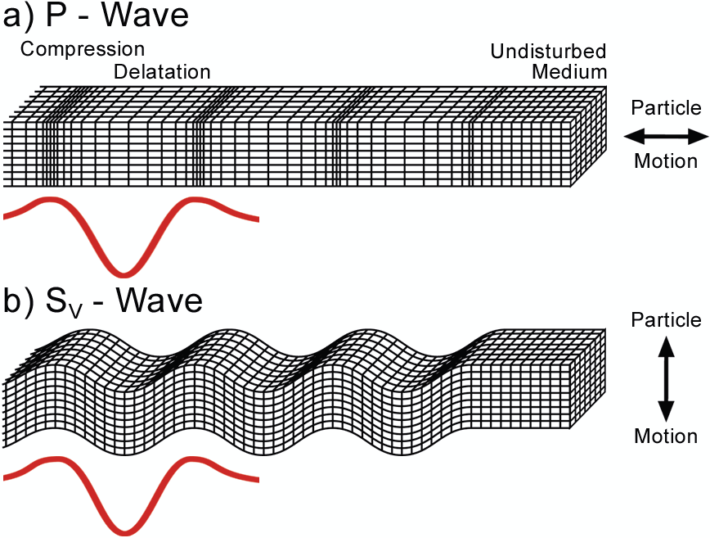
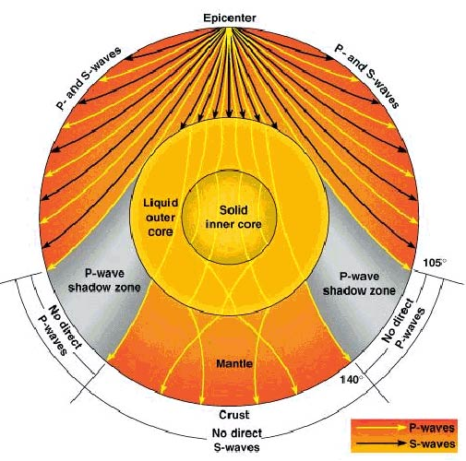
Seismic waves and the Earth’s Interior

Slide 4
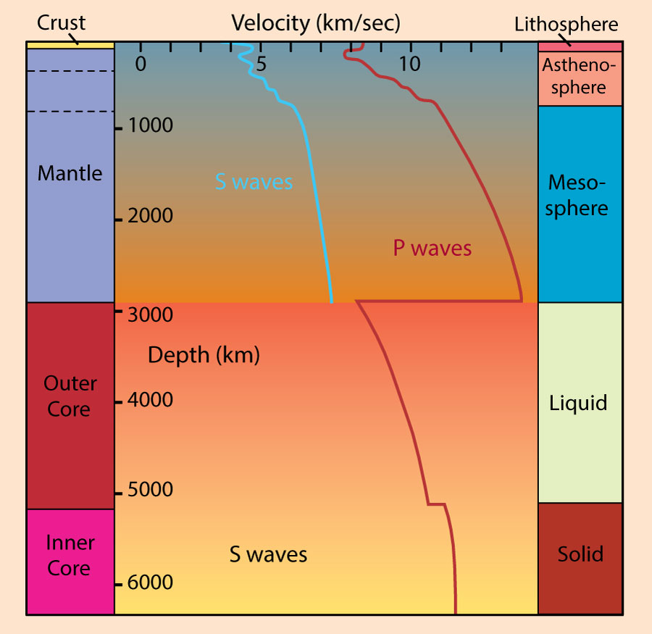
Variation in P and S wave velocities with depth. Compositional subdivisions of the Earth are on the left, rheological subdivisions on the right. After Kearey and Vine (1990), Global Tectonics. © Blackwell Scientific. Oxford.

Slide 5
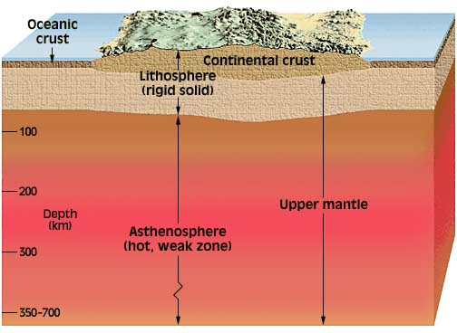
The Earth’s Interior
Crust:
Oceanic crust
Thin: 10 km
Relatively uniform stratigraphy
= ophiolite suite:
sediments
pillow basalt
sheeted dikes
more massive gabbro
ultramafic (mantle)
Continental Crust
Thicker: 20-90 km average ~35 km
Highly variable composition
Average ~ granodiorite

Slide 6
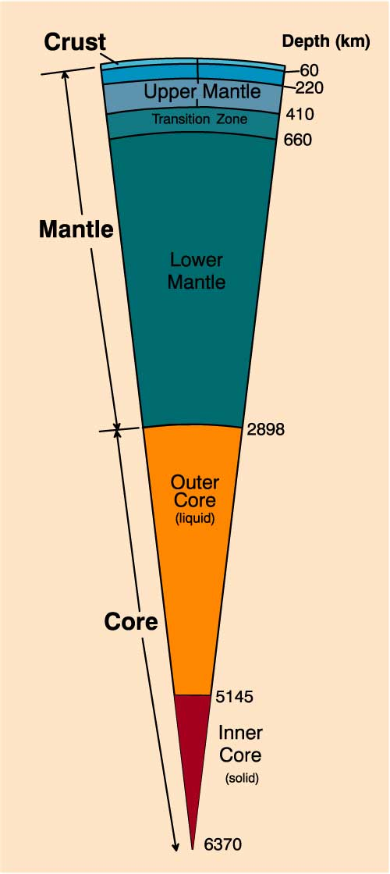
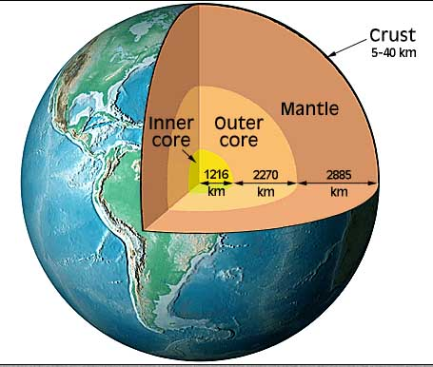
The Earth’s Interior
Mantle:
Peridotite (ultramafic)
Upper to 410 km (olivine → spinel)
Low Velocity Layer 60-220 km
Transition Zone as velocity increases ~ rapidly
660 spinel → perovskite-type
Si^{IV} → Si^{VI}
Lower Mantle has more gradual velocity increase
Major subdivisions of the Earth. Winter (2001) An Introduction to Igneous and Metamorphic Petrology. Prentice Hall.

Slide 7
The Earth’s Interior
Core:
Fe-Ni metallic alloy
Outer Core is liquid
No S-waves
Inner Core is solid
Major subdivisions of the Earth. Winter (2001) An Introduction to Igneous and Metamorphic Petrology. Prentice Hall.

Slide 8
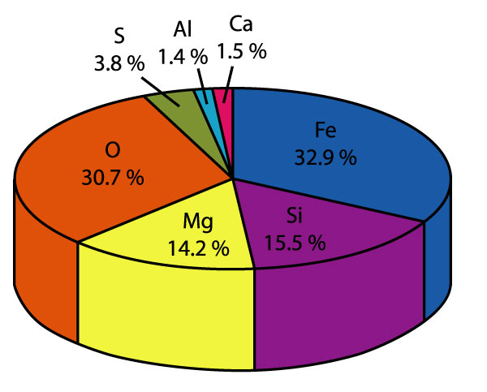
Relative atomic abundances of the seven most common elements that comprise 97% of the Earth's mass. An Introduction to Igneous and Metamorphic Petrology, by John Winter , Prentice Hall.

Slide 9
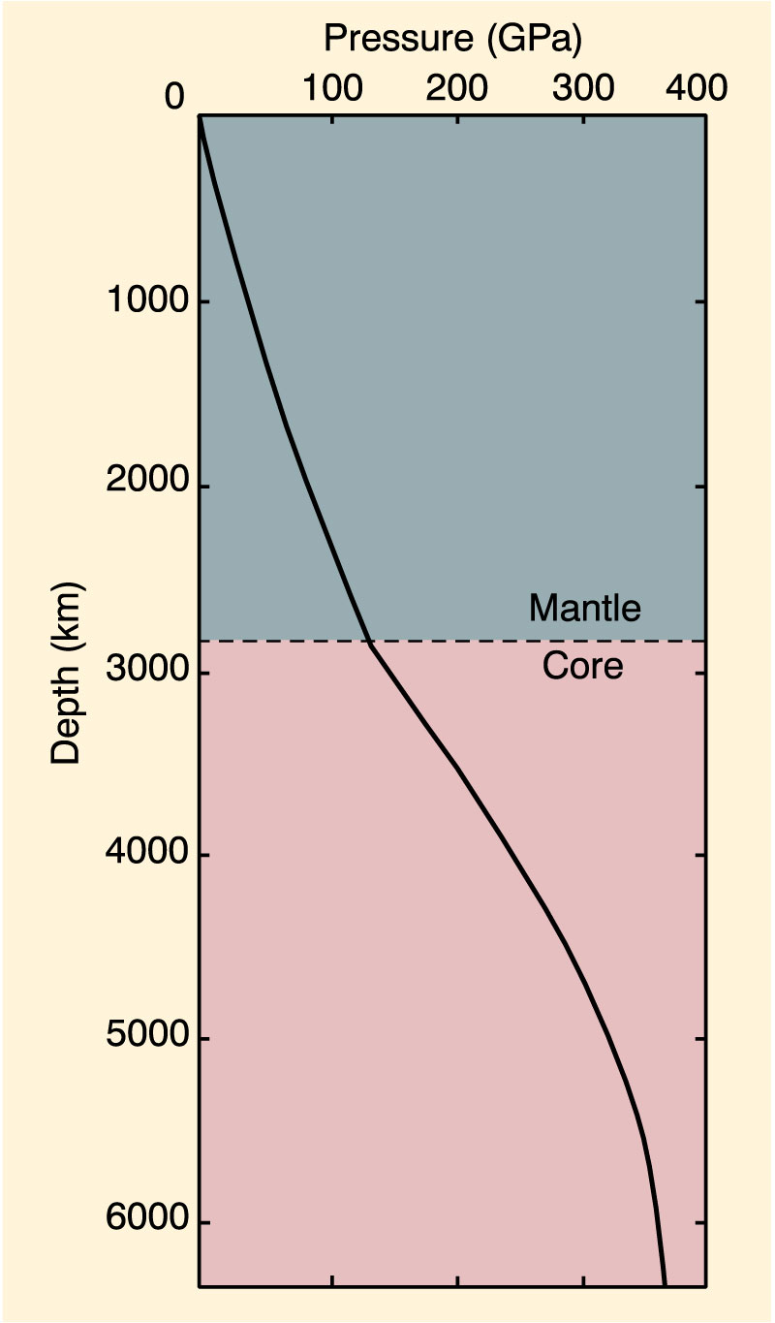
The Pressure Gradient
P increases = ρgh
Nearly linear through mantle
~ 30 MPa/km
≈ 1 GPa at base of ave crust
Core: ρ incr. more rapidly since alloy more dense
Pressure variation with depth. From Dziewonski and Anderson (1981). Phys. Earth Planet. Int., 25, 297-356. © Elsevier Science.

Slide 10
Heat Sources in the Earth
1. Heat from the early accretion and differentiation of the Earth
still slowly reaching surface
2. Heat released by the radioactive breakdown of unstable nuclides

Slide 11
Heat Transfer
1. Radiation (heat transfer from Sun to Earth)
2. Conduction (movement of heat through a substance by the collision of molecules)
3. Convection (transfer of heat by the movement of a fluid (liquid or gas) between areas of different temperature. Warm fluid is less dense than cold fluid, and so convection currents can form in the presence of a temperature gradient.)
Notes:
1. Radiation
Requires transparent medium
Rocks aren’t (except perhaps at great depth)
2. Conduction
Rocks are poor conductors
Very slow
3. Convection
Material movement (requires ductility)
Heat-induced expansion and buoyancy
Much more efficient than conduction

Slide 12
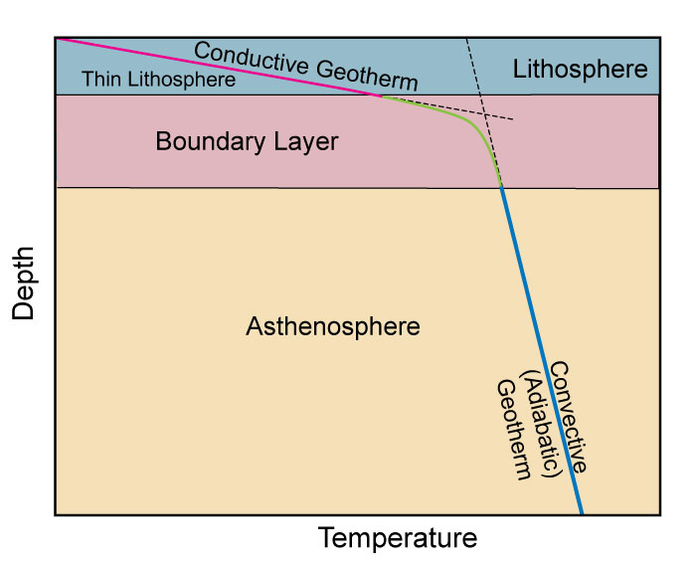
The Geothermal Gradient
Diagrammatic cross-section through the upper 200-300 km of the Earth showing geothermal gradients reflecting more efficient adiabatic (constant heat content) convection of heat in the mobile asthenosphere (steeper gradient in blue) ) and less efficient conductive heat transfer through the more rigid lithosphere (shallower gradient in red). The boundary layer is a zone across which the transition in rheology and heat transfer mechanism occurs (in green). The thickness of the boundary layer is exaggerated here for clarity: it is probably less than half the thickness of the lithosphere.
Notes:
Continental Gradient higher than Oceanic Gradient
Range for both
Highest at Surface
water and cold surface
In the future we will often use average values rather than the ranges

Slide 13
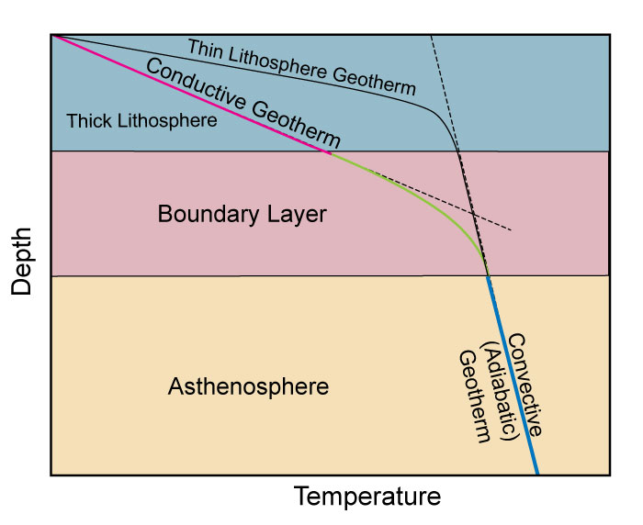
The Geothermal Gradient
A similar example for thick (continental) lithosphere.
Notes:
Continental Gradient higher than Oceanic Gradient
Range for both
Highest at Surface
water and cold surface
In the future we will often use average values rather than the ranges

Slide 14
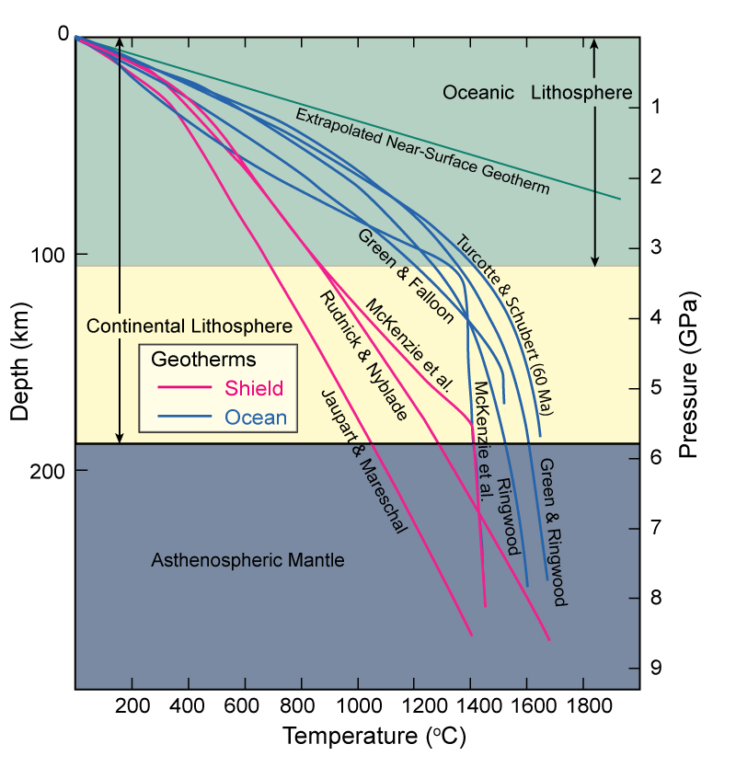
The Geothermal Gradient
Estimates of oceanic (blue curves) and continental shield (red curves) geotherms to a depth of 300 km. The thickness of mature (> 100Ma) oceanic lithosphere is hatched and that of continental shield lithosphere is yellow. Data from Green and Falloon ((1998), Green & Ringwood (1963), Jaupart and Mareschal (1999), McKenzie et al. (2005 and personal communication), Ringwood (1966), Rudnick and Nyblade (1999), Turcotte and Schubert (2002).
Notes:
Continental Gradient higher than Oceanic Gradient
Range for both
Highest at Surface
water and cold surface
In the future we will often use average values rather than the ranges

Slide 15
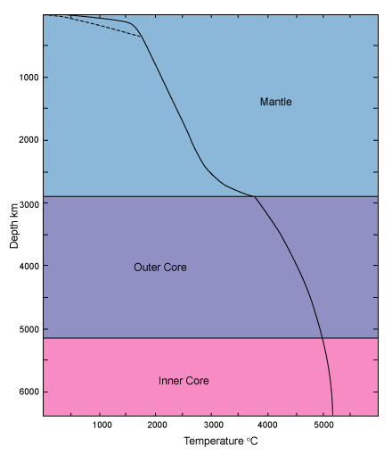
The Geothermal Gradient
Estimate of the geothermal gradient to the center of the Earth (after Stacey, 1992). The shallow solid portion is very close to the Green & Ringwood (1963) oceanic geotherm and the dashed geotherm is the Jaupart & Mareschal (1999) continental geotherm.
Notes:
Continental Gradient higher than Oceanic Gradient
Range for both
Highest at Surface
water and cold surface
In the future we will often use average values rather than the ranges

Slide 16
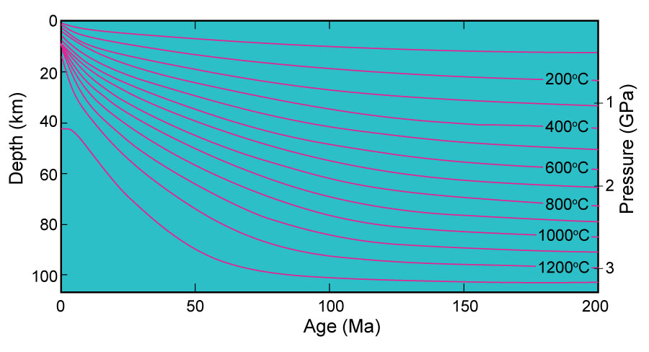
The Geothermal Gradient
Temperature contours calculated for an oceanic plate generated at a mid-ocean ridge (age 0) and thickening as it cools. The 1300ºC isotherm is a reasonable approximation for the base of the oceanic lithosphere. The plate thickens rapidly from zero to 50 Ma and is essentially constant beyond 100 Ma. From McKenzie et al. (2005).

Slide 17
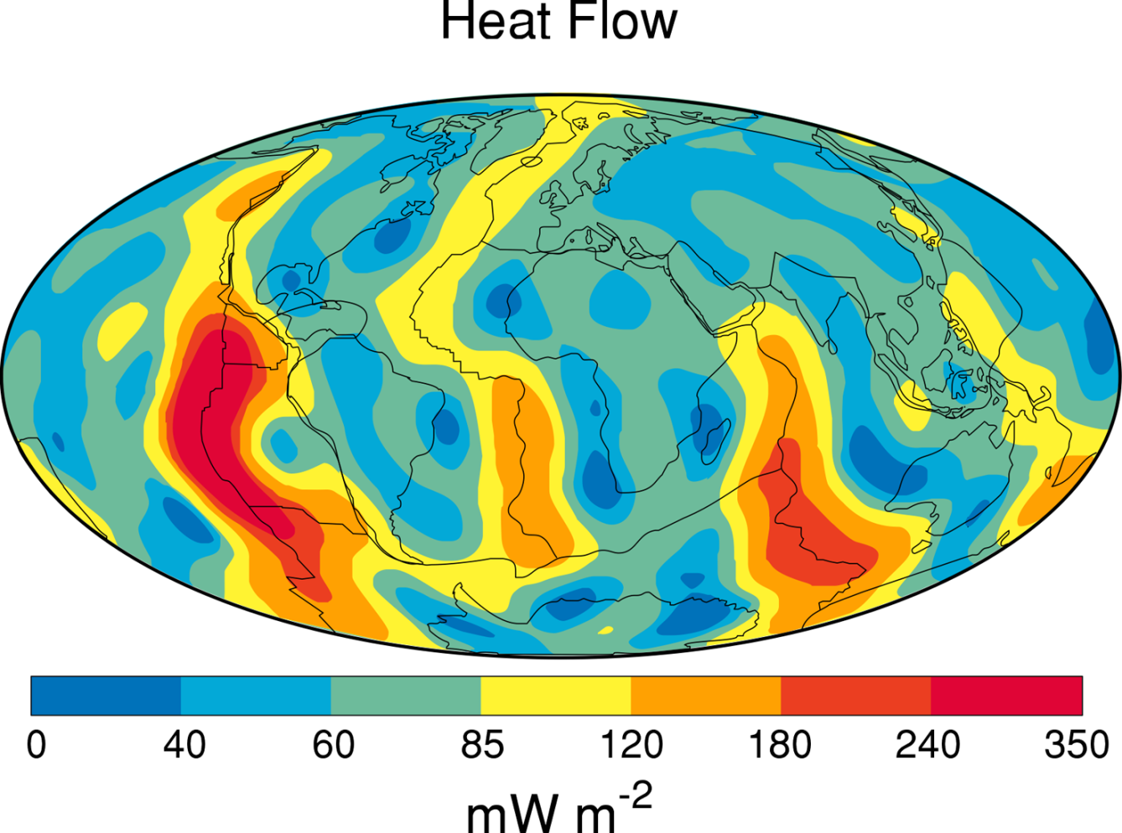
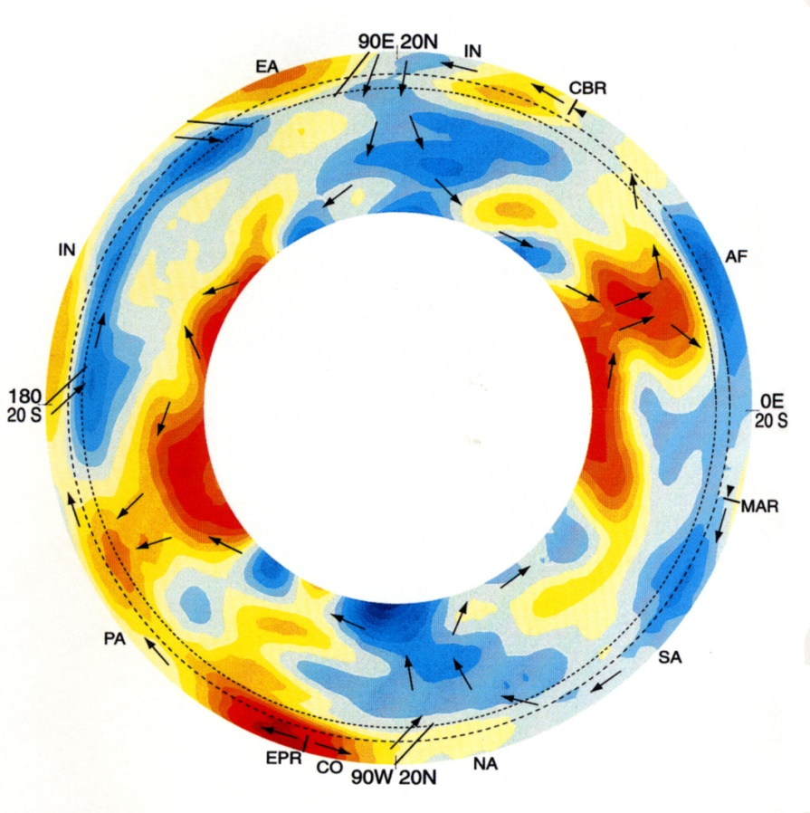
The Geothermal Gradient
Pattern of global heat flux variations compiled from observations at over 20,000 sites and modeled on a spherical harmonic expansion to degree 12. From Pollack, Hurter and Johnson. (1993) Rev. Geophys. 31, 267-280.
Cross-section of the mantle based on a seismic tomography model. Arrows represent plate motions and large-scale mantle flow and subduction zones represented by dipping line segments. EPR =- East pacific Rise, MAR = Mid-Atlantic Ridge, CBR = Carlsberg Ridge. Plates: EA = Eurasian, IN = Indian,
PA = Pacific, NA = North American, SA = South American, AF = African, CO = Cocos. From Li and Romanowicz (1996). J. Geophys. Research, 101, 22,245-72.

Slide 18
Plate tectonics
Cooling mechanisms for a hot planet
If the viscosity is low enough, plumes (in blue) will descend from the cooled upper layer: a form of convection.
Cold plumes descending from a cooled upper boundary layer in a tank of silicone oil. Photo courtesy Claude Jaupart.

Slide 19
Plate tectonics
Cooling mechanisms for a hot planet
For Earth-like viscosity, slabs peel off and descend
Movie clip from Randall Perry, U Maine. http://www.geology.um.maine.edu/geodynamics/analogwebsite/UndergradProjects2005/Perry/html/index.html

Slide 20
Plate tectonics
From: quakeinfo.ucsd.edu/%7Egabi/sio15/Lecture04.html
“Slab Pull” is thus much more effective than “Ridge Push”
But both are poor terms: “slab pull” is really a body force (gravity acting on the entire dense slab..
The old question of whether convection drives plate tectonics or not is also moot: plate tectonics is mantle convection.
The core, however, cools by more vigorous convection which heats the base of the mantle by conduction and initiates plumes (lower viscosity)

Slide 21
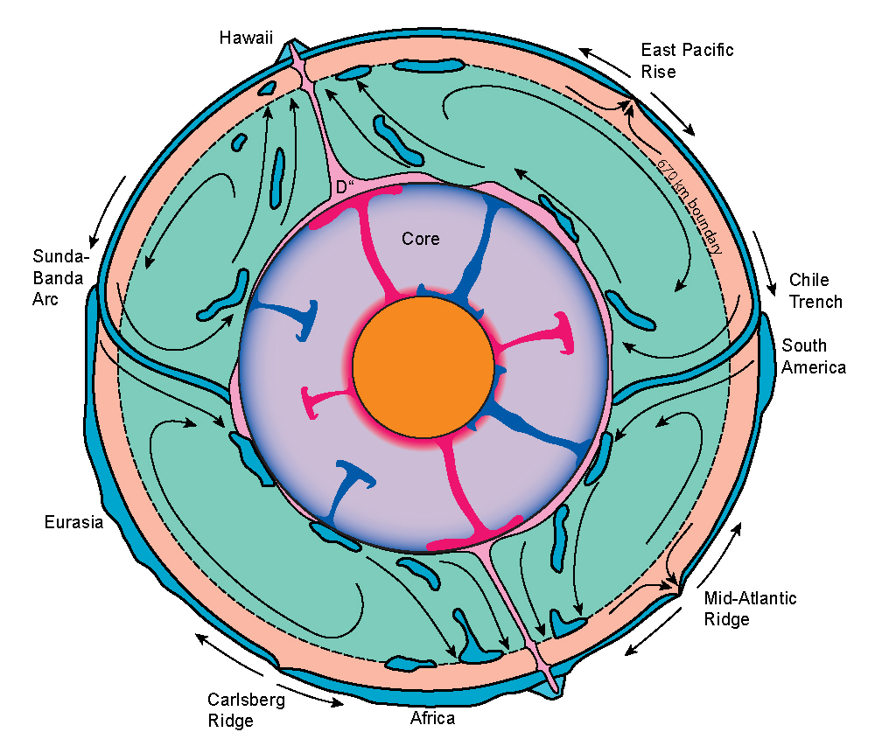
Mantle dynamics
Is the 670 km transition a barrier to whole-mantle convection?
Maybe?
Partly?
No?
Schematic diagram of a 2-layer dynamic mantle model in which the 660 km transition is a sufficient density barrier to separate lower mantle convection (arrows represent flow patterns) from upper mantle flow, largely a response to plate separation. The only significant things that can penetrate this barrier are vigorous rising hotspot plumes and subducted lithosphere (which sink to become incorporated in the D" layer where they may be heated by the core and return as plumes). Plumes in core represent relatively vigorous convection (see Chapter 14). After Silver et al. (1988).
Notes:
Continental Gradient higher than Oceanic Gradient
Range for both
Highest at Surface
water and cold surface
In the future we will often use average values rather than the ranges

Slide 22
Plate Tectonic - Igneous Genesis
1. Mid-Ocean Ridges
2. Intracontinental Rifts
3. Island Arcs
4. Active Continental Margins
5. Back-Arc Basins
6. Ocean Island Basalts
7. Miscellaneous Intra- Continental Activity
kimberlites, carbonatites, anorthosites...

Slide 23
So different rock types (e.g. igneous rocks) are formed under different tectonic settings from different magma (as bulk magma chemistry) at different depths (at different pressure) and different temperature conditions.
This is why we have a large set of rock varieties.
In order to understand how the Earth as a system is working, we need to consider all of these parameters (e.g. P, T, chemistry, ……, age) together.
The relation between the P-T-Chemisty will be the topic of next lecture (some thermodynamics) but now let us classify the igneous rocks.

Slide 24
Classification of Igneous Rocks
Textures:
Aphanitic- crystals too small to see by eye
Phaneritic- can see the constituent minerals
Fine grained- < 1 mm diameter
Medium grained- 1-5 mm diameter
Coarse grained- 5-50 mm diameter
Very coarse grained- > 50 mm diameter
Porphyritic- bimodal grain size distribution
Glassy- no crystals formed

Slide 25
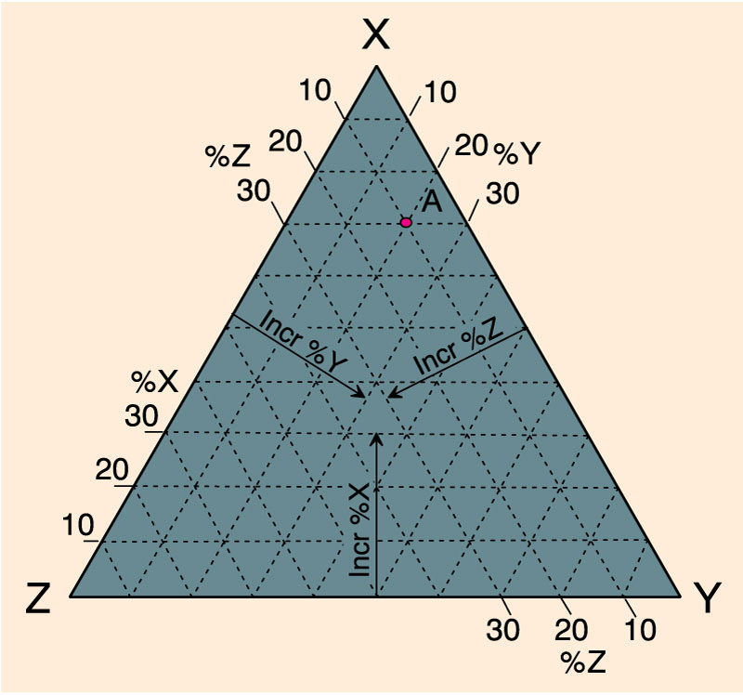
Classification of Igneous Rocks
Plotting a point with the components: 70% X, 20% Y, and 10% Z on triangular diagrams. An Introduction to Igneous and Metamorphic Petrology, John Winter, Prentice Hall.

Slide 26
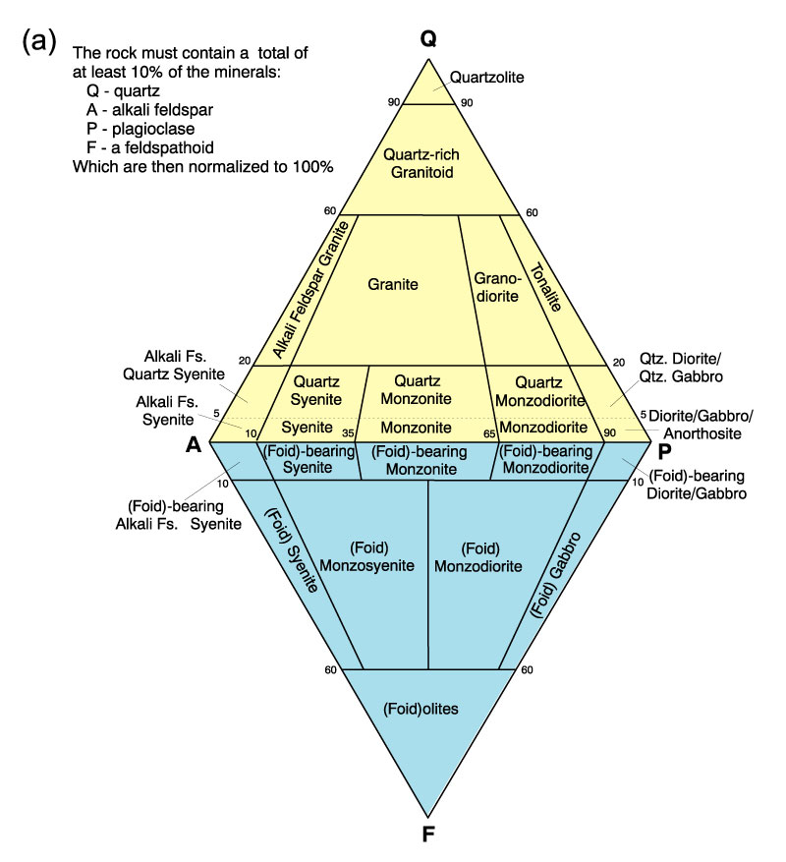
Classification of Igneous Rocks
A classification of the phaneritic igneous rocks: Phaneritic rocks with more than 10% (quartz + feldspar + feldspathoids). After IUGS.

Slide 27
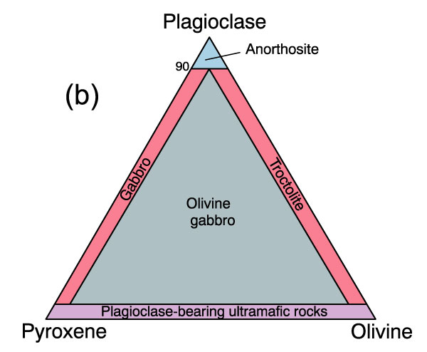
Classification of Igneous Rocks
A classification of the phaneritic igneous rocks: Gabbroic rocks. After IUGS.

Slide 28
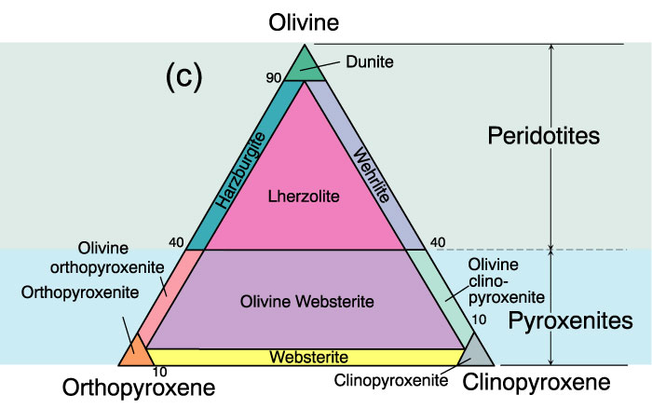
Classification of Igneous Rocks
A classification of the phaneritic igneous rocks: Ultramafic rocks. After IUGS.

Slide 29
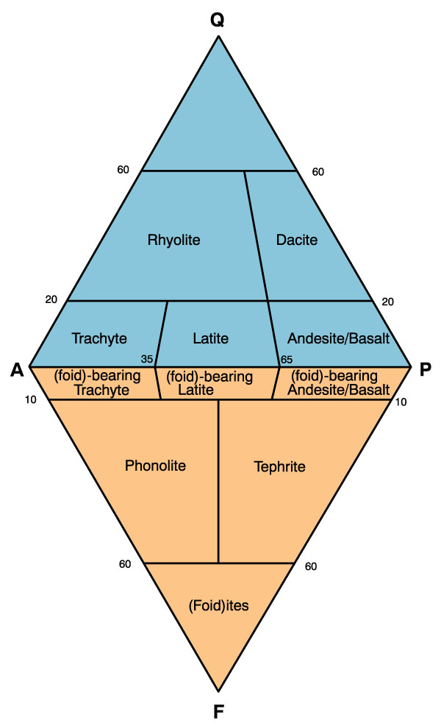
Classification of Igneous Rocks
A classification and nomenclature of volcanic rocks. After IUGS.

Slide 30
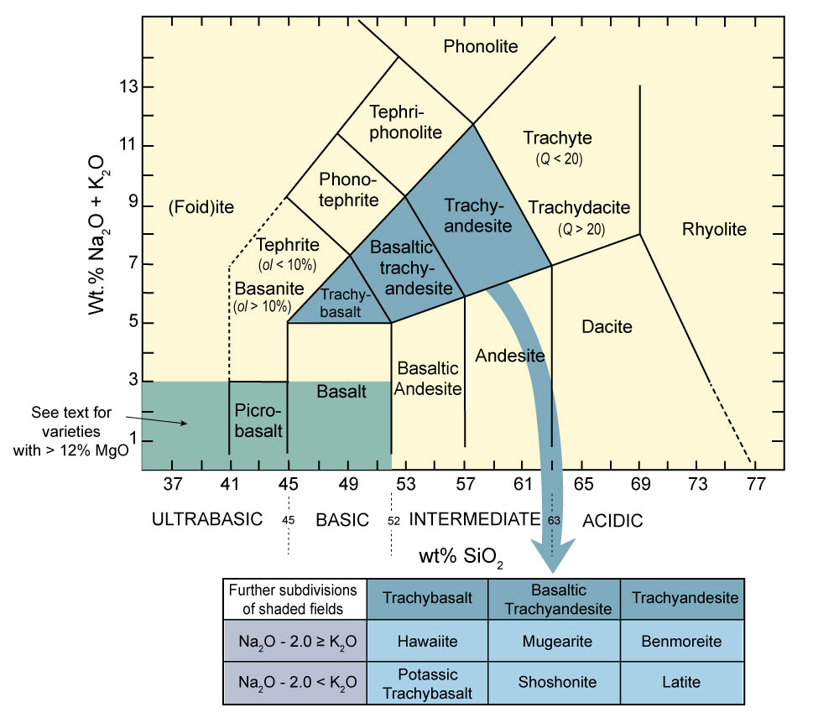
Classification of Igneous Rocks
A chemical classification of volcanics based on total alkalis vs. silica. After Le Maitre (2002) . Igneous Rocks: A Classification and Glossary of Terms. Cambridge University Press.

Slide 31
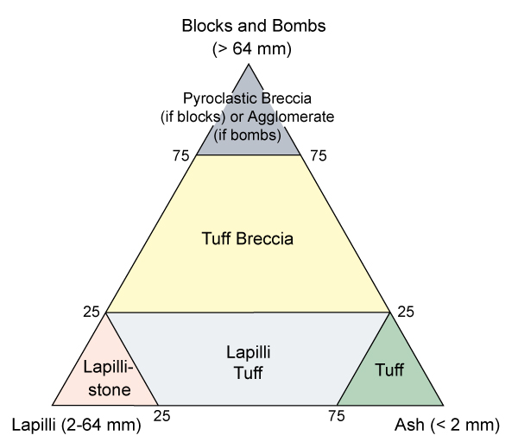
Classification of Igneous Rocks
Classification of the pyroclastic rocks. After Fisher (1966) Earth Sci. Rev., 1, 287-298.

