Slide 1
Igneous Petrology
Lecture 4: Magma generation & Magma diversity
Tamer Abu-Alam
University of Tromsø – The Arctic University of Norway
Tamer.abu-alam@uit.no

Slide 2
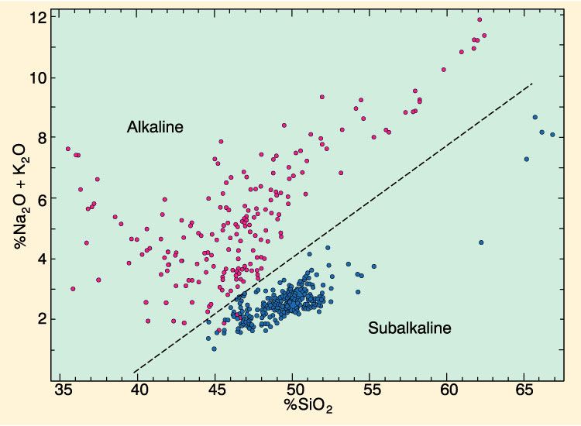
Alkali vs. Silica diagram for Hawaiian volcanics:
Seems to be two distinct groupings: alkaline and subalkaline
Total alkalis vs. silica diagram for the alkaline and sub-alkaline rocks of Hawaii. After MacDonald (1968). GSA Memoir 116
Notes:
Total alkalis vs. silica diagram for the alkaline (red) and sub-alkaline (blue) rocks of Hawaii. After MacDonald (1968). GSA Memoir 116

Slide 3
AFM diagram: can further subdivide the subalkaline magma series into a tholeiitic and a calc-alkaline series
AFM diagram showing the distinction between selected tholeiitic rocks from Iceland, the Mid-Atlantic Ridge, the Columbia River Basalts, and Hawaii (solid circles) plus the calc-alkaline rocks of the Cascade volcanics (open circles). From Irving and Baragar (1971). After Irvine and Baragar (1971). Can. J. Earth Sci., 8, 523-548.
F
h
o
l
e
T
i
i
t
i
c
Na₂O + K₂O (A), FeO + Fe₂O₃ (F),
and MgO (M)
Calc-alkaline
A
M

Slide 4
2 principal types of basalt in the ocean basins
Tholeiitic Basalt and Alkaline Basalt
Common petrographic differences between tholeiitic and alkaline basalts
Tholeiitic Basalt
Alkaline Basalt
Usually fine-grained, intergranular
Usually fairly coarse, intergranular to ophitic
Groundmass
No olivine
Olivine common
Clinopyroxene = augite (plus possibly pigeonite)
Titaniferous augite (reddish)
Orthopyroxene (hypersthene) common, may rim ol.
Orthopyroxene absent
No alkali feldspar
Interstitial alkali feldspar or feldspathoid may occur
Interstitial glass and/or quartz common
Interstitial glass rare, and quartz absent
Olivine rare, unzoned, and may be partially resorbed
Olivine common and zoned
Phenocrysts
or show reaction rims of orthopyroxene
Orthopyroxene uncommon
Orthopyroxene absent
Early plagioclase common
Plagioclase less common, and later in sequence
Clinopyroxene is pale brown augite
Clinopyroxene is titaniferous augite, reddish rims
after Hughes (1982) and McBirney (1993).
Notes:
(a third, minor, one is hi-Al, or calc-alk basalt & will be discussed later)

Slide 5
Primary magmas
Formed at depth and not subsequently modified by FX or Assimilation
Criteria
Highest Mg# (100Mg/(Mg+Fe)) really → parental magma
Experimental results of lherzolite melts
Mg# = 66-75
Cr > 1000 ppm
Ni > 400-500 ppm
Multiply saturated (We refer to a melt that is saturated in several phases at once as a multiply saturated melt).

Slide 6
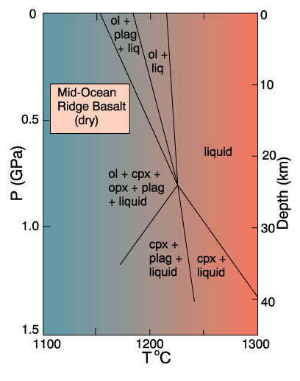
Multiple saturation
Low P
Ol then Plag then Cpx as cool
~70ºC T range
Figure 10.13 Anhydrous P-T phase relationships for a mid-ocean ridge basalt suspected of being a primary magma. After Fujii and Kushiro (1977). Carnegie Inst. Wash. Yearb., 76, 461-465.

Slide 7
Multiple saturation
Low P
Ol then Plag then Cpx as cool
70ºC T range
High P
Cpx then Plag then Ol
Figure 10.13 Anhydrous P-T phase relationships for a mid-ocean ridge basalt suspected of being a primary magma. After Fujii and Kushiro (1977). Carnegie Inst. Wash. Yearb., 76, 461-465.

Slide 8
Multiple saturation
Low P
Ol then Plag then Cpx as cool
70ºC T range
High P
Cpx then Plag then Ol
25 km get all at once
= Multiple saturation
Suggests that 25 km is the depth of last eq^{m} with the mantle
Notes:
Multiple saturation implies that the liquid corresponding to the melted basalt in the experiment was in equilibrium with Ol + Cpx + Plag at 25 km depth
This is the appropriate mineralogy for a lherzolite at this depth

Slide 9
What is/are the source(s) of such parent or primary magma?

Slide 10
Sources of mantle material
Ophiolites
Slabs of oceanic crust and upper mantle
Thrust at subduction zones onto edge of continent
Dredge samples from oceanic crust
Nodules and xenoliths in some basalts
Kimberlite xenoliths
Diamond-bearing pipes blasted up from the mantle carrying numerous xenoliths from depth

Slide 11
Lherzolite is probably fertile unaltered mantle
Dunite and harzburgite are refractory residuum after basalt has been extracted by partial melting
15
Tholeiitic basalt
10
Partial Melting
Wt.% Al₂O₃
Figure 10-1 Brown and Mussett, A. E. (1993), The Inaccessible Earth: An Integrated View of Its Structure and Composition. Chapman & Hall/Kluwer.
5
Lherzolite
Harzburgite
Residuum
0
Dunite
0.0
0.2
0.4
0.6
0.8
Wt.% TiO₂

Slide 12
Lherzolite: A type of peridotite with Olivine > Opx + Cpx
Olivine
Dunite
90
Peridotites
Wehrlite
Harzburgite
Lherzolite
40
Orthopyroxenite
Olivine Websterite
Pyroxenites
10
10
Websterite
Orthopyroxene
Clinopyroxenite
Clinopyroxene
Figure 2.2 C After IUGS

Slide 13
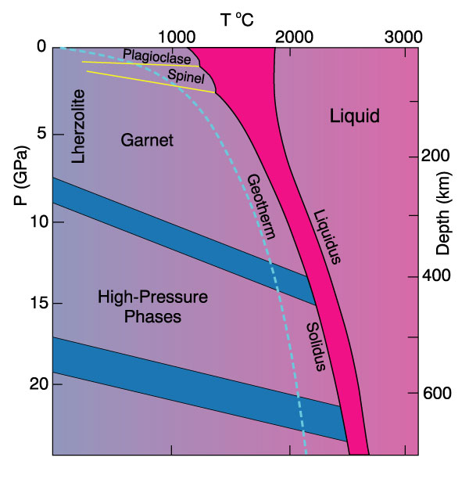
Phase diagram for aluminous 4-phase lherzolite:
Al-phase =
Plagioclase
shallow (< 50 km)
Spinel
50-80 km
Garnet
80-400 km
Si → VI coord.
> 400 km
Figure 10.2 Phase diagram of aluminous lherzolite with melting interval (gray), sub-solidus reactions, and geothermal gradient. After Wyllie, P. J. (1981). Geol. Rundsch. 70, 128-153.
Notes:
Note: the mantle will not melt under normal ocean geotherm!

Slide 14
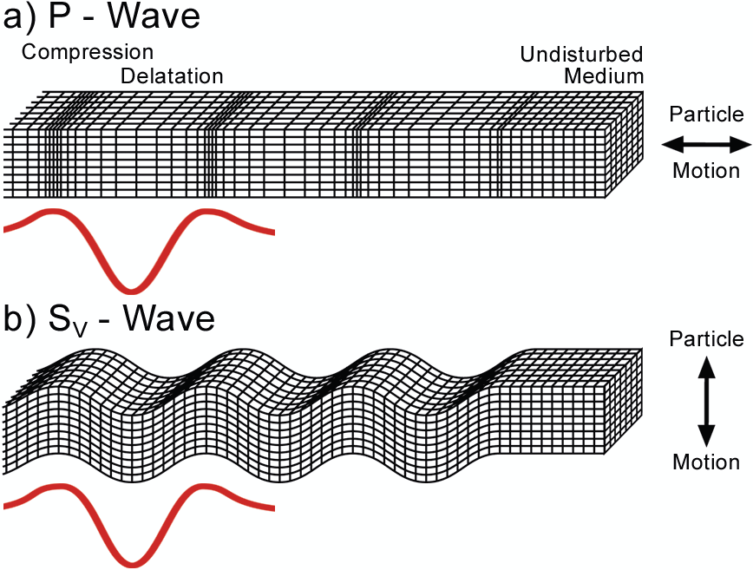
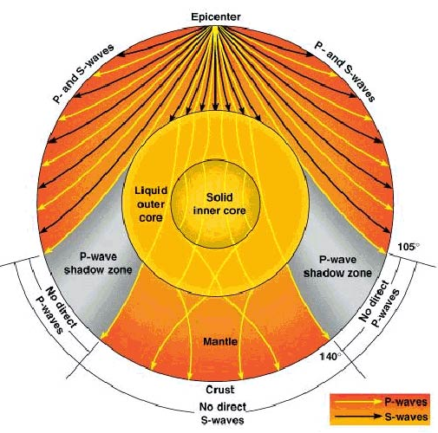
Seismic waves and the Earth’s Interior
Longitudinal wave
transverse wave

Slide 15
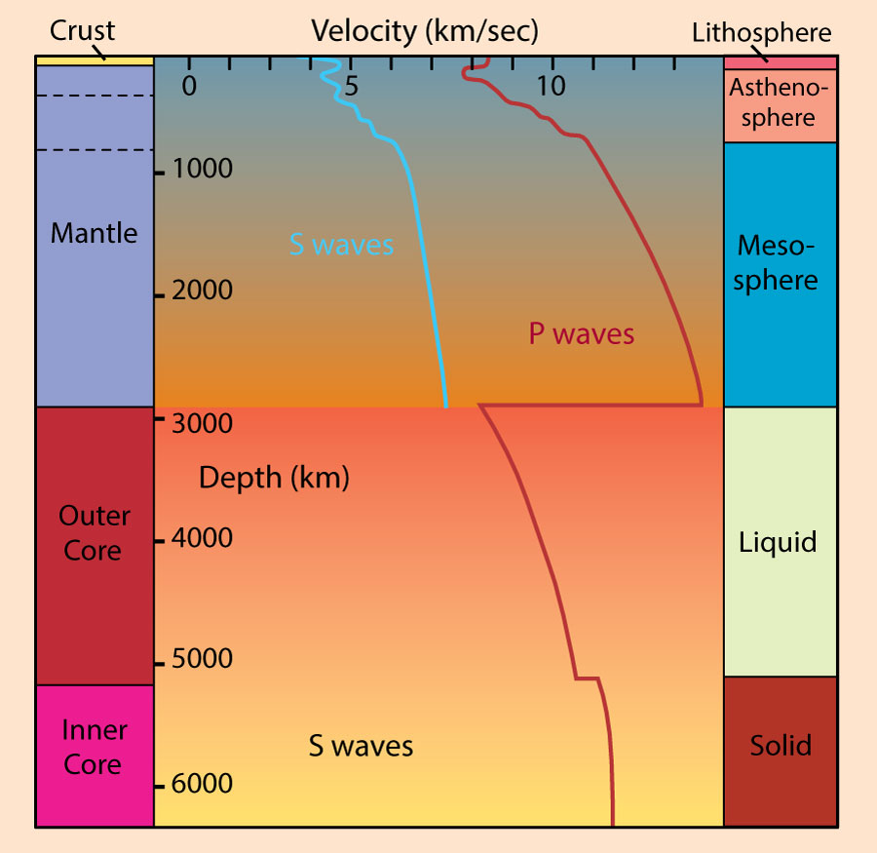
Variation in P and S wave velocities with depth. Compositional subdivisions of the Earth are on the left, rheological subdivisions on the right. After Kearey and Vine (1990), Global Tectonics. © Blackwell Scientific. Oxford.

Slide 16
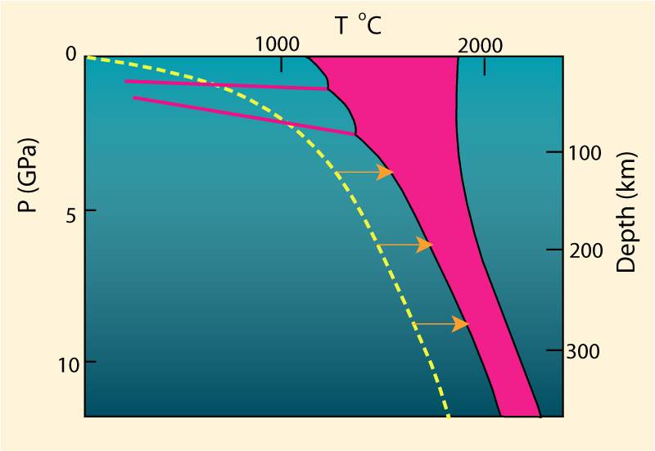
How does the mantle melt??
1) Increase the temperature
Figure 10.3. Melting by raising the temperature.
Notes:
No realistic mechanism for the general case
Local hot spots OK
very limited area

Slide 17
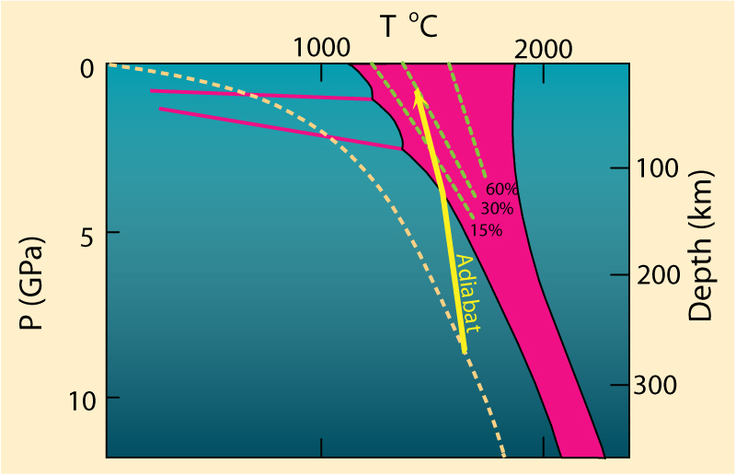
2) Lower the pressure
Adiabatic rise of mantle with no conductive heat loss
Decompression partial melting could melt at least 30%
Figure 10.4. Melting by (adiabatic) pressure reduction. Melting begins when the adiabat crosses the solidus and traverses the shaded melting interval. Dashed lines represent approximate % melting.
Notes:
Adiabatic rise of mantle with no conductive heat loss
Steeper than solidus
Intersects solidus
Δ slope = heat of fusion as mantle melts
Decompression melting could melt at least 30%

Slide 18
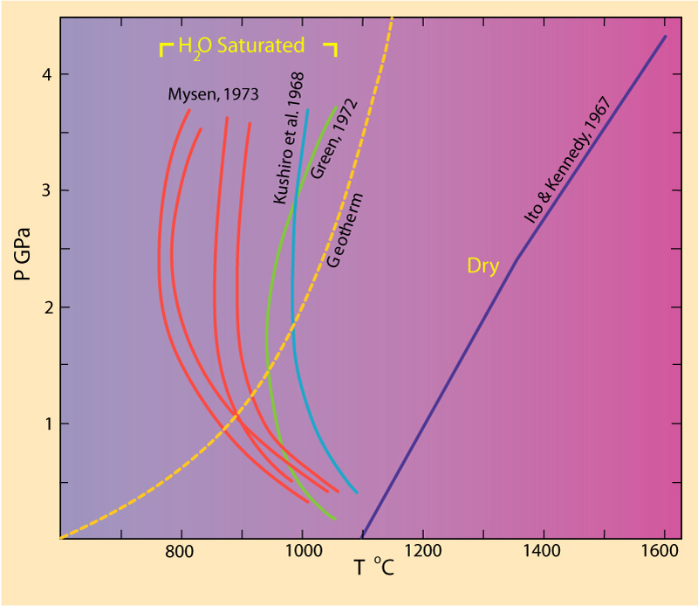
3) Add volatiles (especially H₂O)
Figure 10.4. Dry peridotite solidus compared to several experiments on H2O-saturated peridotites.
Notes:
Remember solid + water = liq_{(aq)} and LeChatelier
Dramatic lowering of melting point of peridotite

Slide 19
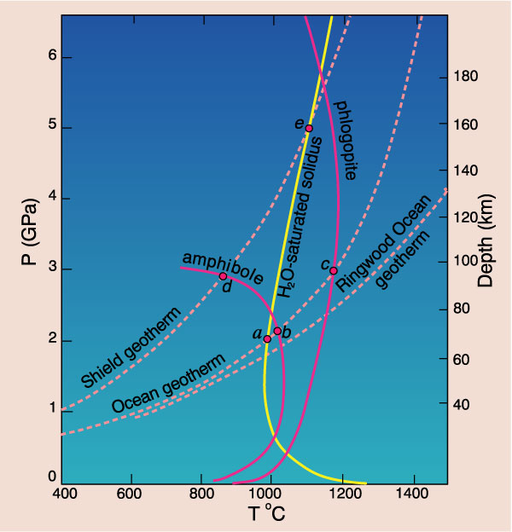
Heating of amphibole-bearing peridotite
1) Ocean geotherm
2) Shield geotherm
Figure 10.6 Phase diagram (partly schematic) for a hydrous mantle system, including the H2O-saturated lherzolite solidus of Kushiro et al. (1968), the dehydration breakdown curves for amphibole (Millhollen et al., 1974) and phlogopite (Modreski and Boettcher, 1973), plus the ocean and shield geotherms of Clark and Ringwood (1964) and Ringwood (1966). After Wyllie (1979). In H. S. Yoder (ed.), The Evolution of the Igneous Rocks. Fiftieth Anniversary Perspectives. Princeton University Press, Princeton, N. J, pp. 483-520.
Notes:
Requires T > both 1) dehydration and 2) water-sat melting curves
Can only create 1-2% melt
not sufficient to even separate from the source
may explain low velocity layer at 100 km
hornblende (b) is at 70 km
phlogopite (c) is at 95 km
Uncertainty in curves and geotherms can −> melting of mica or hornblende at 100 km

Slide 20
Melts can be created under realistic circumstances
Plates separate and mantle rises at mid-ocean ridges
Adibatic rise → decompression melting
Hot spots → localized plumes of melt
Fluid fluxing may give LVL
Also important in subduction zones and other settings

Slide 21
Is melting of mantle enough to produce Alkaline and Tholiitic basaltic magma?

Slide 22
Generation of tholeiitic and alkaline basalts from a chemically uniform mantle
Variables (other than X)
Temperature
Pressure
Figure 10.2 Phase diagram of aluminous lherzolite with melting interval (gray), sub-solidus reactions, and geothermal gradient. After Wyllie, P. J. (1981). Geol. Rundsch. 70, 128-153.
Notes:
Variables (other than X)
Temperature
= % partial melting
Pressure
Fig. 10-2 indicates that, although the chemistry may be the same, the mineralogy varies
Pressure effects on eutectic shift

Slide 23
Pressure effects:
Figure 10.8 Change in the eutectic (first melt) composition with increasing pressure from 1 to 3 GPa projected onto the base of the basalt tetrahedron. After Kushiro (1968), J. Geophys. Res., 73, 619-634.
Notes:
Increased pressure moves the ternary eutectic minimum from the oversaturated tholeiite field to the under-saturated alkaline basalt field
Alkaline basalts are thus favored by greater depth of melting

Slide 24
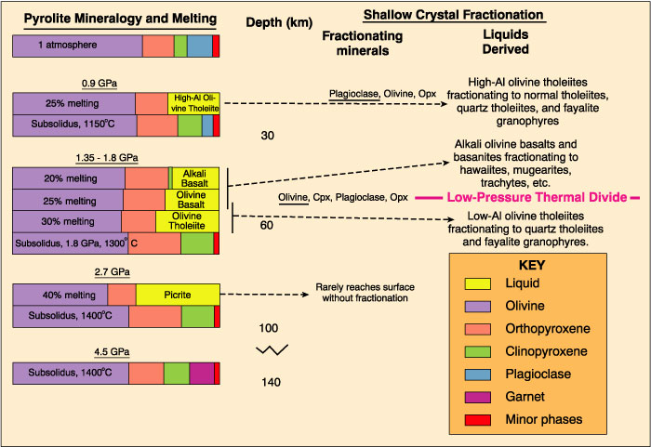
Liquids and residuum of melted mantle (experimental)
Figure 10.9 After Green and Ringwood (1967). Earth Planet. Sci. Lett. 2, 151-160.
Notes:
Tholeiite produced at < 30 km depth by 25% PM
60 km
Alkalis are incompatible so tend to concentrate in first low % partial melts
20% PM -> alkaline basalt
30% PM -> tholeiite (only 25% or less at 30 km so looks like tholeiitic nature suppressed with depth)
Note that residuum is Ol + Opx (harzburgite)
Note also the thermal divide between thol and alk at low pressure for FX

Slide 25
Initial Conclusions:
Tholeiites favored by shallower melting
25% melting at <30 km → tholeiite
25% melting at 60 km → olivine basalt
Tholeiites favored by greater % partial melting (F)
20 % melting at 60 km → alkaline basalt
incompatibles (alkalis) → initial melts
30 % melting at 60 km → tholeiite

Slide 26
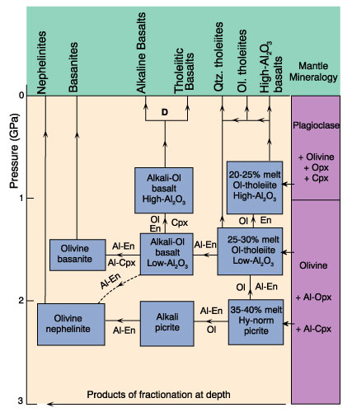
Crystal Fractionation of magmas as they rise
Figure 10.10 Schematic representation of the fractional crystallization scheme of Green and Ringwood (1967) and Green (1969). After Wyllie (1971). The Dynamic Earth: Textbook in Geosciences. John Wiley & Sons.

Slide 27
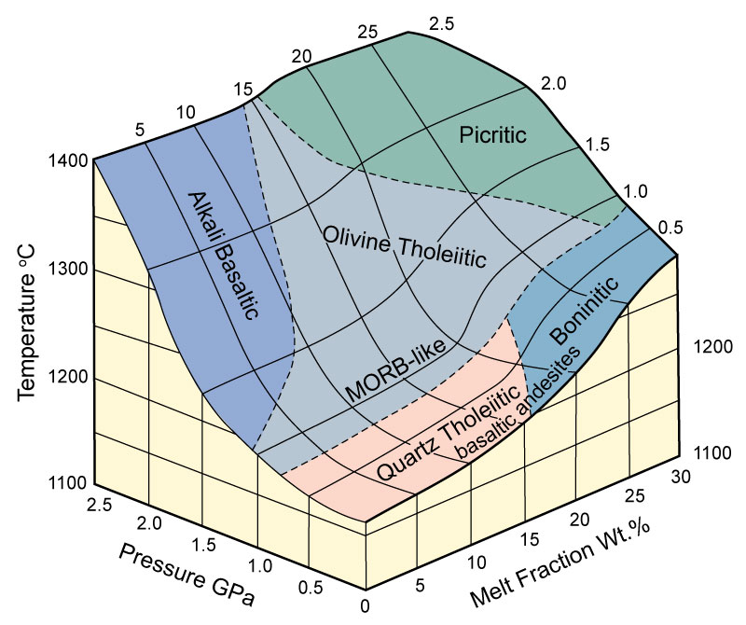
Other, more recent experiments on melting of fertile (initially garnet-bearing) lherzolite confirm that alkaline basalts are favored by high P and low F
Figure 10.11 After Kushiro (2001).
Notes:
Tholeiite produced at < 30 km depth by 25% PM
60 km
Alkalis are incompatible so tend to concentrate in first low % partial melts
20% PM -> alkaline basalt
30% PM -> tholeiite (only 25% or less at 30 km so looks like tholeiitic nature suppressed with depth)
Note that residuum is Ol + Opx (harzburgite)
Note also the thermal divide between thol and alk at low pressure for FX

Slide 28
Summary
A chemically homogeneous mantle can yield a variety of basalt types
Alkaline basalts are favored over tholeiites by deeper melting and by low % PM
Fractionation at moderate to high depths can also create alkaline basalts from tholeiites
Why alkaline magma can be produced at low %PM??
Notes:
In spite of this initial success, there is evidence to suggest that such a simple approach is not realistic, and that the mantle is chemically heterogeneous

Slide 29
Review of REE
10.00
8.00
6.00
sample/chondrite
4.00
2.00
0.00
La Ce Nd Sm Eu Tb Er Yb Lu
atomic number
increasing incompatibility
Notes:
If the mantle is unmodified, it should have the chemistry of a chondrite (we think)
How would it plot on a REE diagram?
Now what happens to partial melts of this mantle??

Slide 30
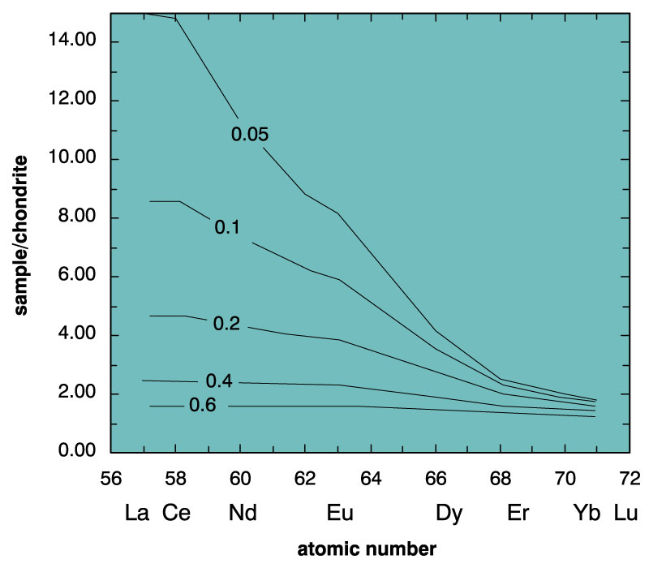
Review of REE
Figure 9.4. Rare Earth concentrations (normalized to chondrite) for melts produced at various values of F via melting of a hypothetical garnet lherzolite using the batch melting model (equation 9-5). From Winter (2001) An Introduction to Igneous and Metamorphic Petrology. Prentice Hall.
increasing incompatibility
Notes:
Enrich LREE > HREE
Greater enrichment for lower % PM

Slide 31
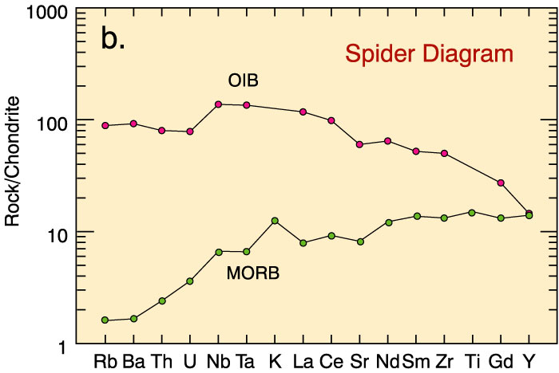
Spider diagram for oceanic basalts
increasing incompatibility
Figure 10.14b. Spider diagram for a typical alkaline ocean island basalt (OIB) and tholeiitic mid-ocean ridge basalt (MORB). From Winter (2001) An Introduction to Igneous and Metamorphic Petrology. Prentice Hall. Data from Sun and McDonough (1989).
Notes:
Same approach for larger variety of elements
Still OIB looks like partial melt of ~ typical mantle
MORB still has (+) slope
Looks like two mantle reservoirs
MORB source is depleted by melt extraction
OIB source is not depleted
is it enriched?

Slide 32
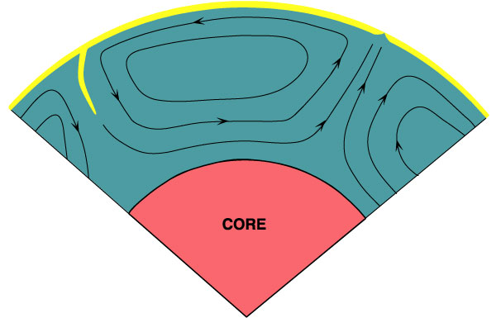
“Whole Mantle” circulation model
Figure 10-17a After Basaltic Volcanism Study Project (1981). Lunar and Planetary Institute.
Notes:
Homogeneous mantle
Large-scale convection (drives plate tectonics?)

Slide 33
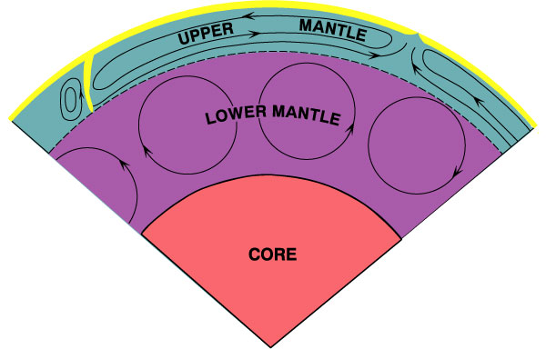
“Two-Layer” circulation model
Upper depleted mantle = MORB source (tholiitic)
Lower undepleted & enriched OIB source (Alkaline)
Figure 10-17b After Basaltic Volcanism Study Project (1981). Lunar and Planetary Institute.
Notes:
Layered mantle
Upper depleted mantle = MORB source
depleted by MORB extraction > 1 Ga
Lower = undepleted & enriched OIB source
Boundary = 670 km phase transition
Sufficient Δ density to impede convection so they convect independently
It is interesting to note that this concept of a layered mantle was initiated by the REE concentrations of oceanic basalts
Later support came from isotopes and geophysics

Slide 34
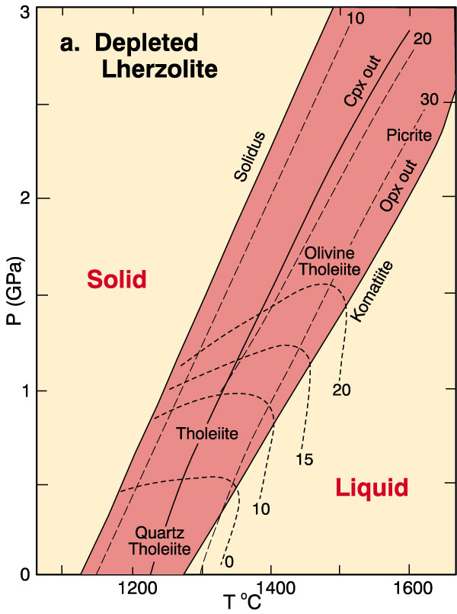
Experiments on melting enriched vs. depleted mantle samples:
1. Depleted Mantle
Tholeiite easily created
by 10-30% PM
More silica saturated
at lower P
Figure 10-18a. Results of partial melting experiments on depleted lherzolites. Dashed lines are contours representing percent partial melt produced. Strongly curved lines are contours of the normative olivine content of the melt. “Opx out” and “Cpx out” represent the degree of melting at which these phases are completely consumed in the melt. After Jaques and Green (1980). Contrib. Mineral. Petrol., 73, 287-310.

Slide 35
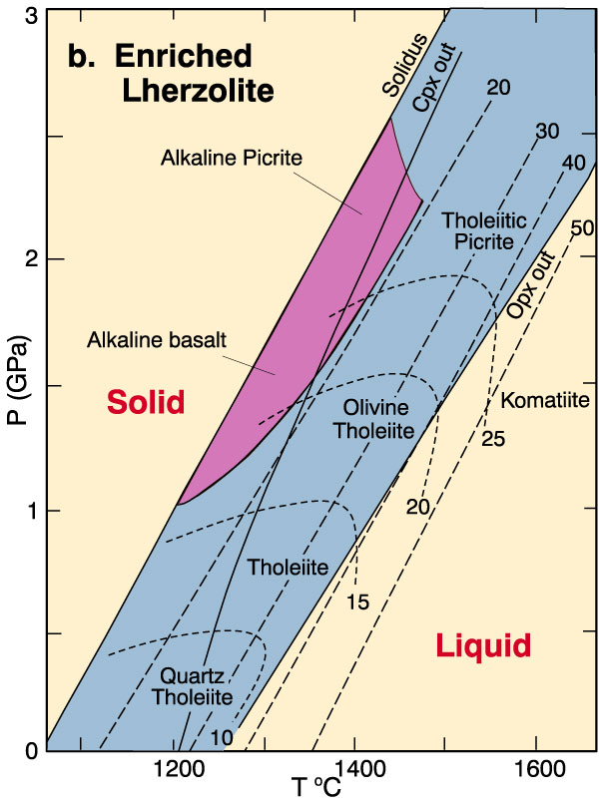
Experiments on melting enriched vs. depleted mantle samples:
2. Enriched Mantle
Tholeiites extend to
higher P than for DM
Alkaline basalt field
at higher P yet
And lower % PM
Figure 10-18b. Results of partial melting experiments on fertile lherzolites. Dashed lines are contours representing percent partial melt produced. Strongly curved lines are contours of the normative olivine content of the melt. “Opx out” and “Cpx out” represent the degree of melting at which these phases are completely consumed in the melt. The shaded area represents the conditions required for the generation of alkaline basaltic magmas. After Jaques and Green (1980). Contrib. Mineral. Petrol., 73, 287-310.

Slide 36
So far, we can understand how the tholiitic and alkaline
basaltic magma can be produced from mantle.
What is about other types of rocks (acidic and
intermediate magma)???

Slide 37
Diversification of Magmas
Notes:
We have now created a primary magma by partial melting of the mantle
It is a basalt
Can we get the diversity of igneous rocks that we find at the surface from this parent?
If so, how?
If not, what other process(es) are necessary?

Slide 38
Magmatic Differentiation
Any process by which a magma is able to diversify and produce a magma or rock of different composition

Slide 39
Magmatic Differentiation
Two essential processes
1. Creates a compositional difference in one or more phases
2. Preserves the chemical difference by segregating (or fractionating) the chemically distinct portions
Notes:
1. Creates a compositional difference in one or more phases as elements partition themselves in response to a change in an intensive variable, such as pressure, temperature, or composition
This will determine the trend of the differentiation process
2. Preserves the chemical difference by segregating (or fractionating) the chemically distinct portions so that they may either form a rock, or continue to evolve as separate systems
The effectiveness of the fractionation process determines extent of differentiation proceeds along a particular trend
Most common: differentiation involving the physical separation of phases in multi-phase systems
The effectiveness depends upon contrasts in physical properties such as density, viscosity, diffusivity, and size/shape
The energy is usually thermal or gravitational
The phases that are fractionated in magmatic systems can be either liquid-solid, liquid-liquid, or liquid-vapor

Slide 40
Partial Melting
Crystal Fractionation
Volatile Transport
Liquid Immiscibility
The Soret Effect and thermogravitational Diffusion
Magma Mixing
Assimilation

Slide 41
Partial Melting
Separation of a partially melted liquid from the solid residue
Notes:
Involves the partitioning of chemical constituents
Can produce a variety of melt compositions from a single source
Discussed already, only recap here

Slide 42
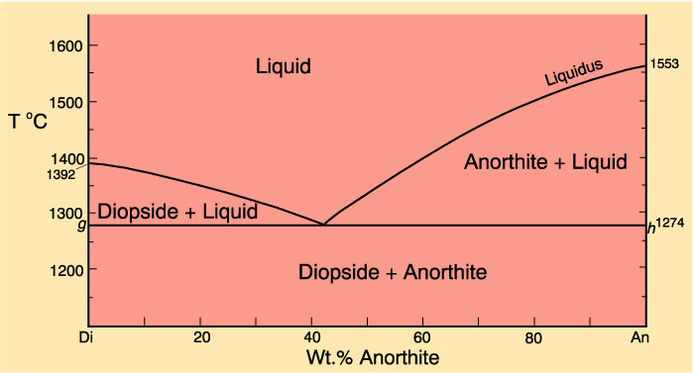
Effects of removing liquid at various stages of melting
Eutectic systems
First melt always = eutectic composition
Major element composition of eutectic melt is constant until one of the source mineral phases is consumed (trace elements differ)
Once a phase is consumed,
the next increment of melt will
be different X and T
Notes:
Trace element behavior (Chapter 9): several models for crystallization and melting (batch melting, Rayleigh fractional melting...)
X of a melt produced by partial melting of a particular source is a function of the pressure, temperature (the fraction of the source that is melted)

Slide 43
Separation of a partially melted liquid from the solid residue requires a critical melt %
Sufficient melt must be produced for it to
Form a continuous, interconnected film
Have enough interior volume that it is not all of it is adsorbed to the crystal surfaces

Slide 44
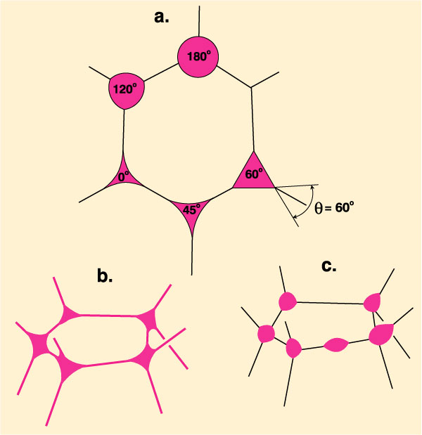
The ability to form an interconnected film is dependent upon the dihedral angle (θ) a property of the melt
Figure 11.1 Illustration of the dihedral angle (θ) of melt droplets that typically form at multiple grain junctions. After Hunter (1987) In I. Parsons (ed.), Origins of Igneous Layering. Reidel, Dordrecht, pp. 473-504.
Notes:
Figure 11-1.
b. When a melt has a low dihedral angle the surface energy of the melt ≈ that of the minerals, and melt tends to “wet” the surfaces and form a continuous network
c. Higher surface energy contrasts result in higher τηετα and isolated melt droplets
Mafic systems τηετα < 50º very small melt fractions should be extractable
Rhyolitic melts may have higher angles (45-60º)
Viscosity is also important in terms of segregation of a melt once a continuous network formed
The critical melt fraction (or rheological critical melt percentage, RCMP): % melt at which a crystal-dominated, high viscosity granular framework gives way to a melt-dominated, lower viscosity suspension
Theoretical system of spheres: RCMP = 26% melt
Irregular shapes and variable sizes: RCMP may vary between 30-50% for static situations involving granitic compositions
But other factors may play a role

Slide 45
Crystal Fractionation
Dominant mechanism by which most magmas, once formed, differentiate?
Notes:
Chapters 6 and 7: effects of removing crystals as they formed (compared to equilibrium crystallization) on the liquid line of descent

Slide 46
Gravity settling
The differential motion of crystals and liquid under the influence of gravity due to their differences in density
Notes:
Observations
Sinking of crystals in experiments
Natural occurrences: plutons and cumulates

Slide 47
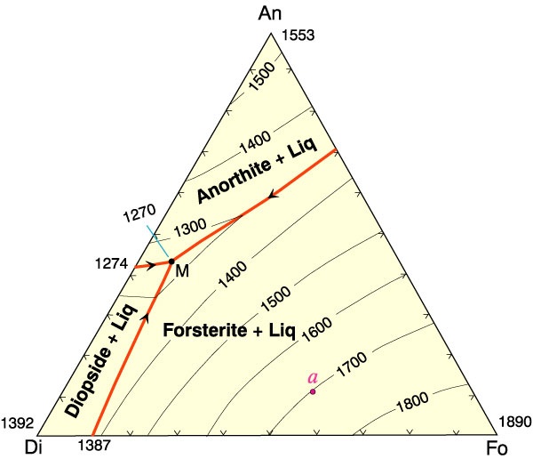
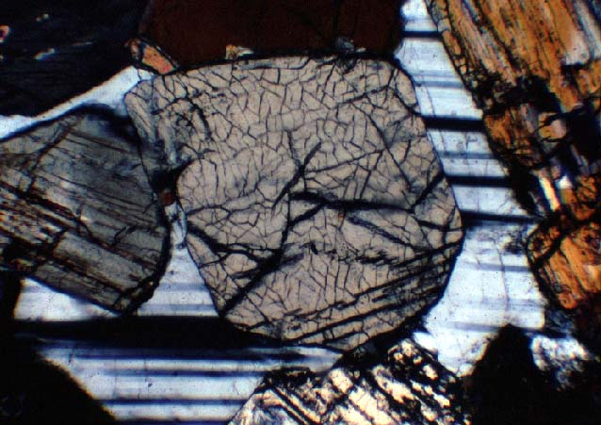
Gravity settling
Cool point a → olivine layer at base of pluton if first olivine sinks
Next get ol+cpx layer
finally get ol+cpx+plag
Figure 7-2. After Bowen (1915), A. J. Sci., and Morse (1994), Basalts and Phase Diagrams. Krieger Publishers.
Cumulate texture:
Mutually touching phenocrysts with interstitial crystallized residual melt

Slide 48
Two other mechanisms that facilitate the separation of crystals and liquid
1. Compaction
Notes:
In addition to gravity settling there are two other mechanisms that facilitate the separation of crystals and liquid
1. Compaction (mentioned in reference to partial melting) is also quite possible in crystal mushes that form as cumulates or suspended crystals

Slide 49
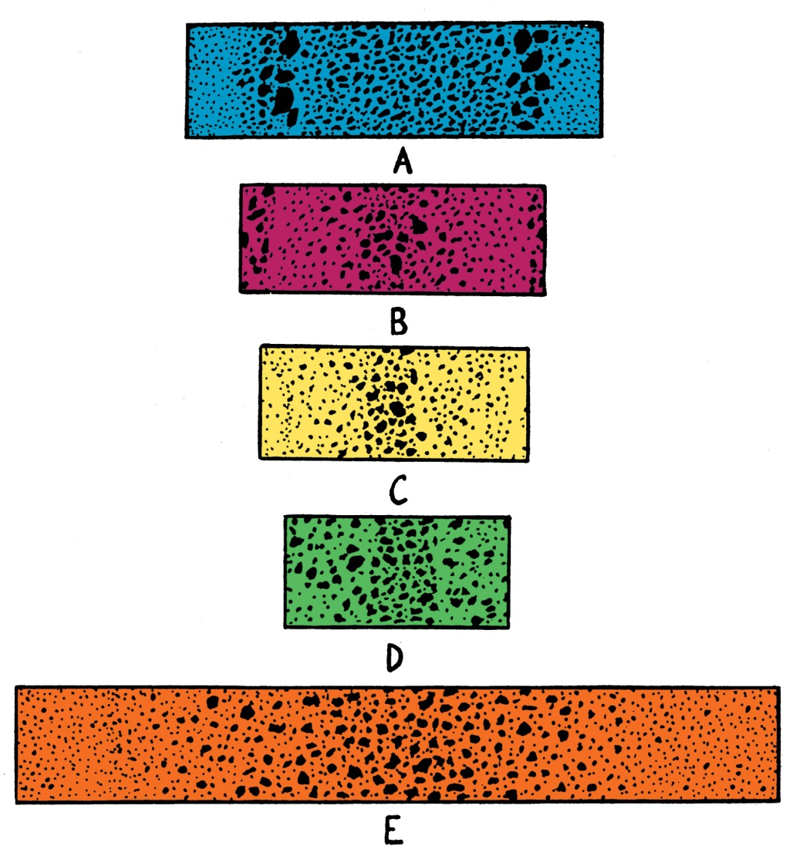
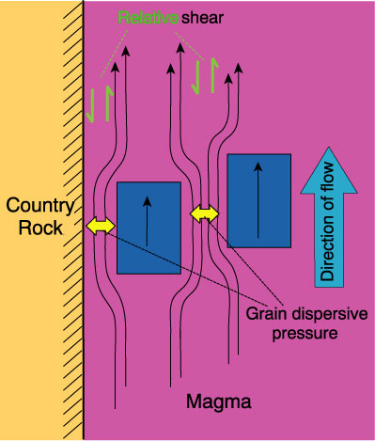
Two other mechanisms that facilitate the separation of crystals and liquid
2. Flow segregation
Figures 11.4 and 11.5 Drever and Johnston (1958). Royal Soc. Edinburgh Trans., 63, 459-499.
Notes:
The motion of the magma past the stationary walls of the country rock creates shear in the viscous liquid
Magma must flow around phenocrysts, thereby exerting pressure on them at constrictions where phenocrysts are near one another or the contact
→ grain dispersive pressure, forcing the grains apart and away from the contact
This is probably a relatively minor effect

Slide 50
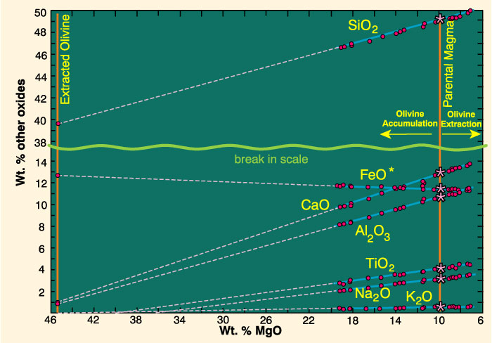
Figure 11.2 Variation diagram using MgO as the abscissa for lavas associated with the 1959 Kilauea eruption in Hawaii. After Murata and Richter, 1966 (as modified by Best, 1982)
Notes:
1959 Kilauea lavas in Hawaii
The parent magma (asterisks) was estimated from the most primitive glass found
Variation accounted for by extraction and accumulation of olivine phenocrysts
Linear fit is a good indicator of the process

Slide 51
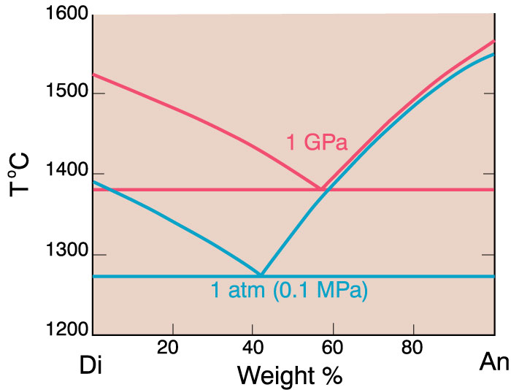
Polybaric Fractional Crystallization
1. Stability of phases will change (hi-P)

Slide 52
Polybaric Fractional Crystallization
1. Stability of phases changes (hi-P)
2. Shift of the eutectic point with pressure will cause the quantity of the liquidus phases to vary
Notes:
Esp. increase in the size of the olivine field with decreasing pressure → much more olivine forms as the melt composition follows the liquidus away from the olivine side of the phase diagram - see next frame

Slide 53
Hi-P
Low-P
Ol
Pyx
Notes:
Thus, the amount of olivine that crystallizes with a rising basaltic magma will be greater that the amount that forms during isobaric crystallization

Slide 54
Volatile Transport
Vapor released by heating of hydrated or carbonated wall rocks
As a volatile-bearing (but undersaturated) magma rises and pressure is reduced, the magma may eventually become saturated in the vapor, and a free vapor phase will be released
A third mechanism for generating a separate fluid phase is a result of late-stage fractional crystallization

Slide 55
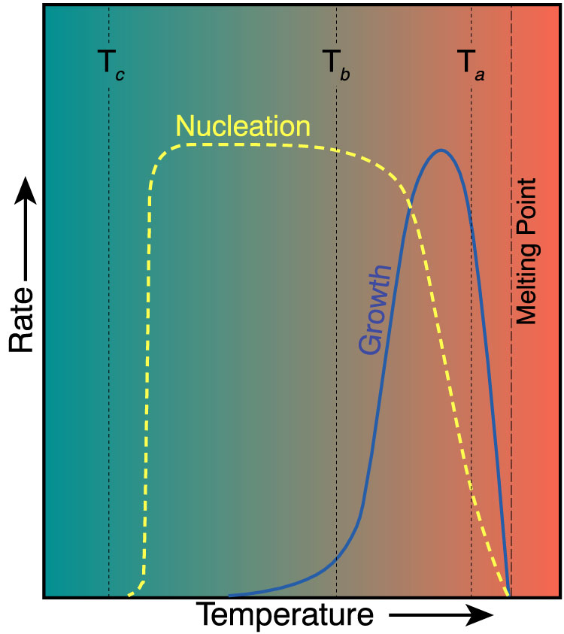
Volatile release raises liquidus temperature → porphyritic texture
May increase P - fracture the roof rocks
Vapor and melt escape along fractures as dikes
Silicate melt → quartz and feldspar
→ small dikes of aplite
Vapor phase → dikes or pods of pegmatite
Notes:
May increase P at the top of the intrusion and fracture the roof rocks in some shallow intrusions (may initiate volcanic eruptions)
Vapor and some late silicate melt escape along a network of fractures as dikes of various sizes
Large grain size of pegmatite due to poor nucleation and high diffusivity in the water-rich phase

Slide 56
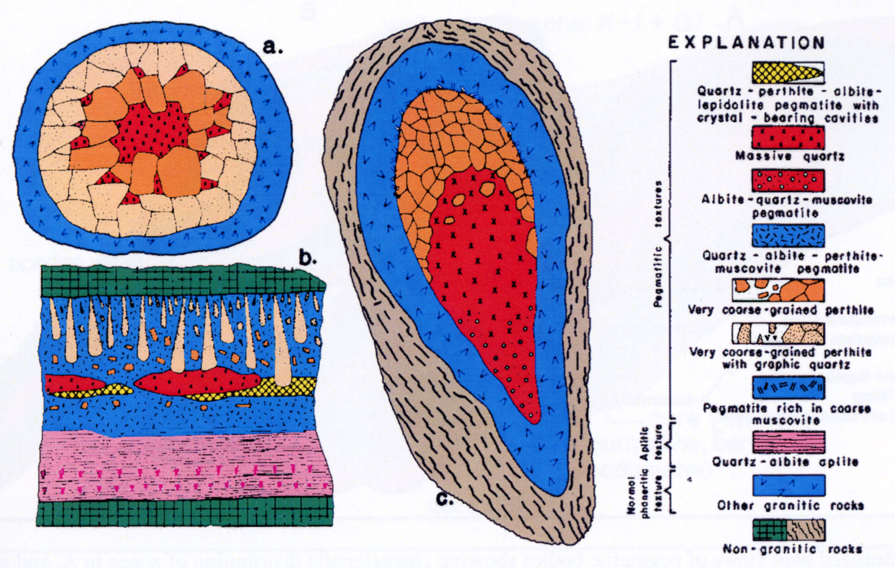
Concentrate incompatible elements
Complex: varied mineralogy
May display concentric zonation
Figure 11.6 Sections of three zoned fluid-phase deposits (not at the same scale). a. Miarolitic pod in granite (several cm across). b. Asymmetric zoned pegmatite dike with aplitic base (several tens of cm across). c. Asymmetric zoned pegmatite with granitoid outer portion (several meters across). From Jahns and Burnham (1969). Econ. Geol., 64, 843-864.
Notes:
Most pegmatites are simple, and essentially very coarse granites
Others are more complex such as those above
Miarolitic pods or cavities = fluid segregations trapped in the plutonic host

Slide 57
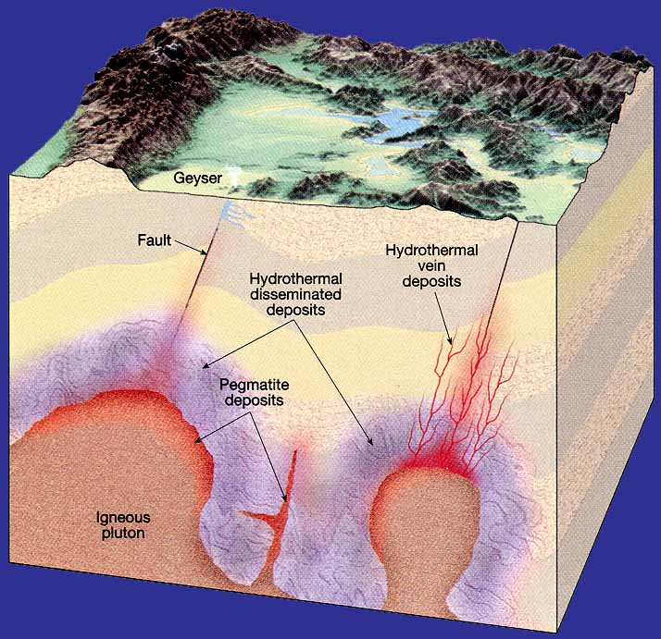
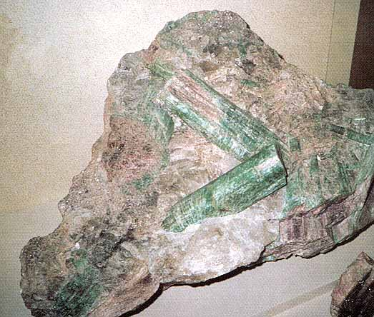
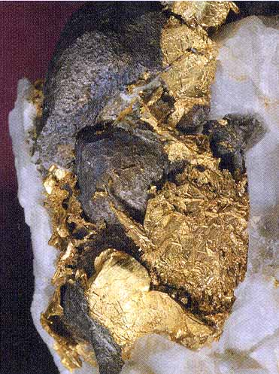
8 cm tourmaline crystals from pegmatite
The large grain size in magmagenic pegmatites
is not due to a slow cooling rate but is a result of poor
nucleation and very high diffusivity in the H2O-rich phase,
which permits chemical species to migrate readily and add to
rapidly growing minerals.
5 mm gold from a hydrothermal deposit

Slide 58
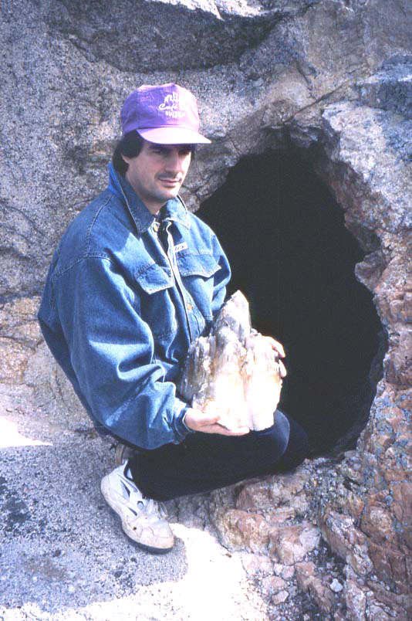
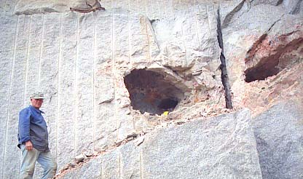
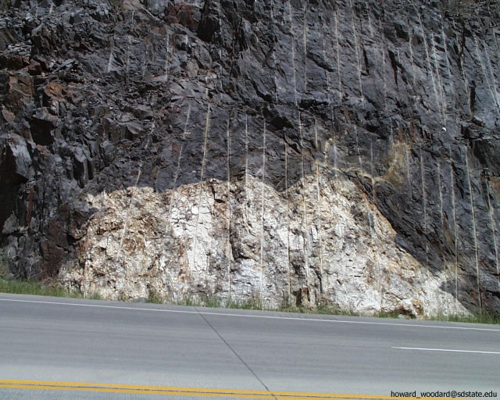
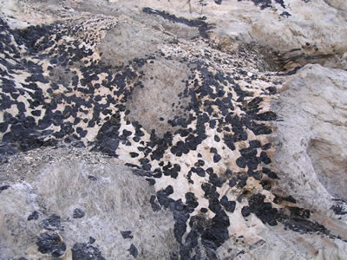
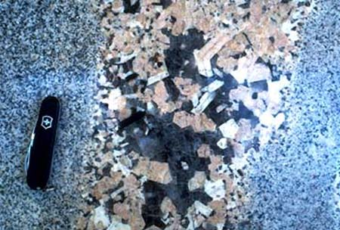
Pegmatites

Slide 59
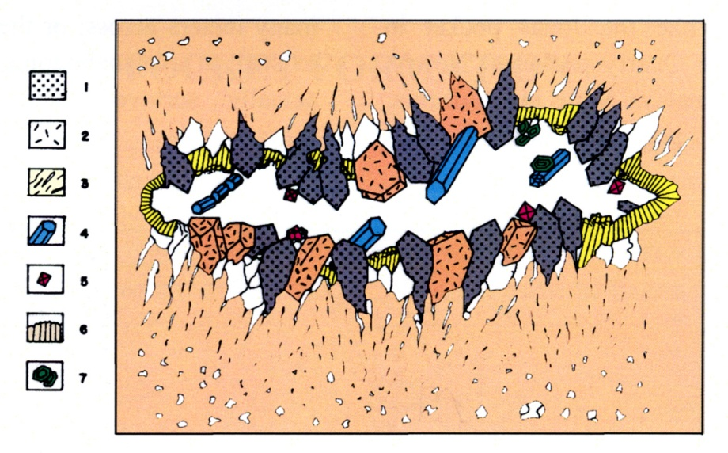
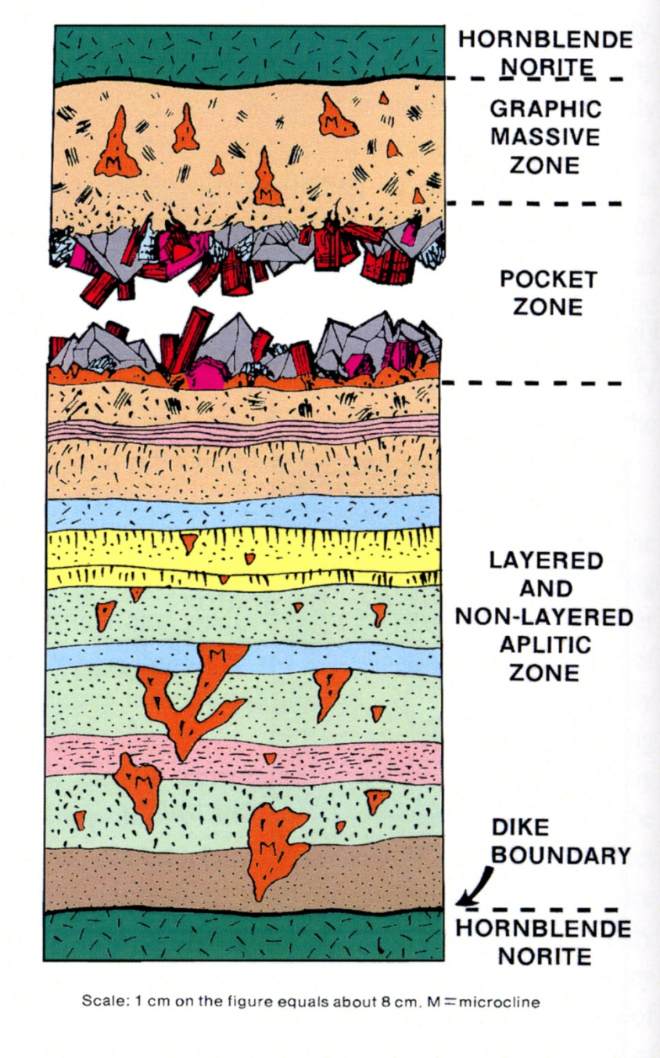
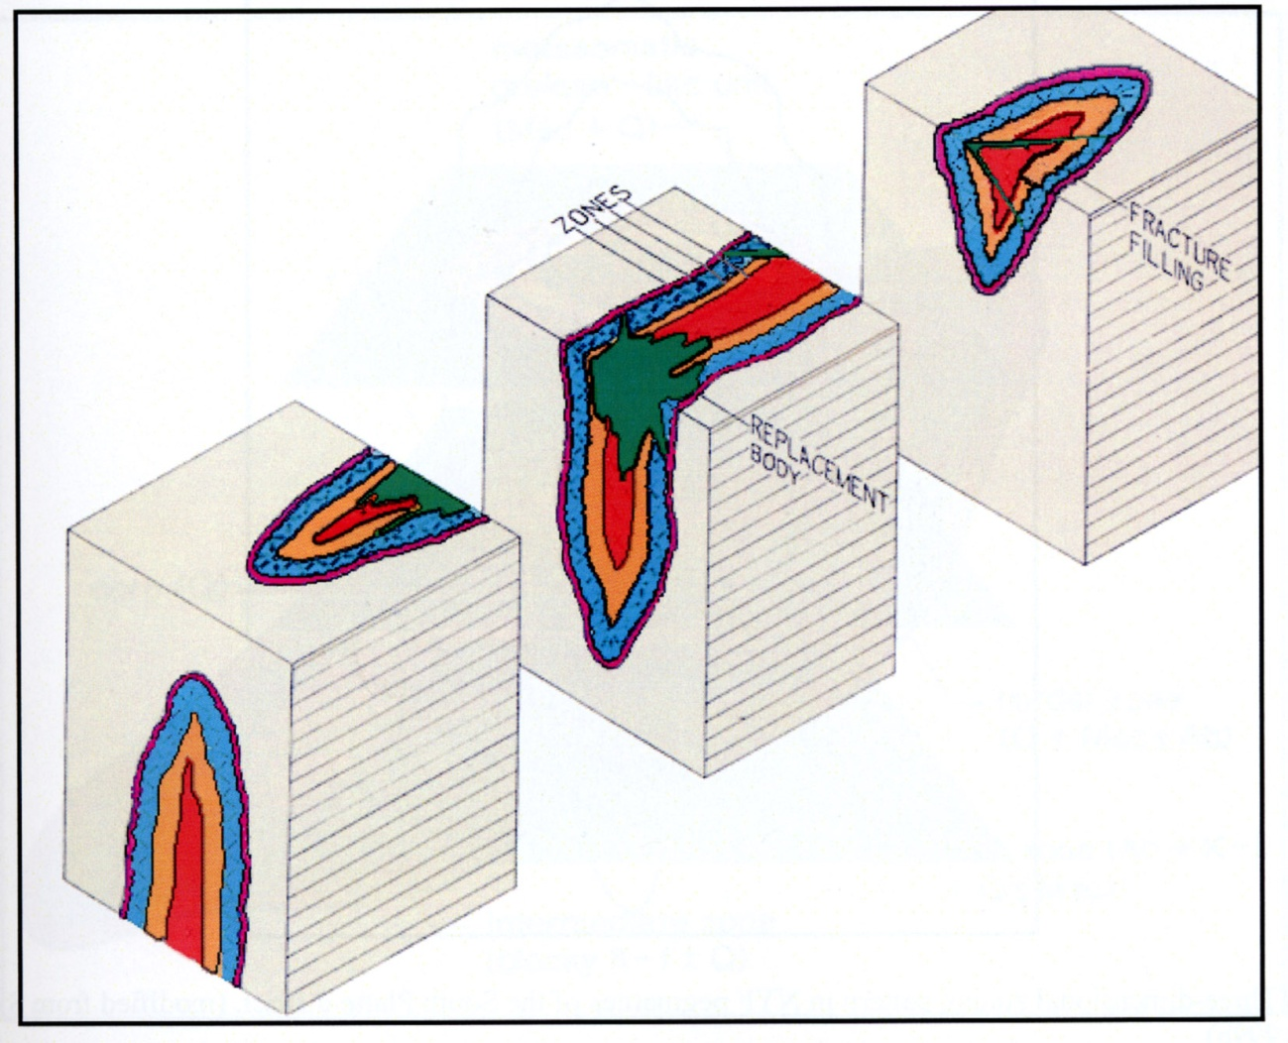

Slide 60
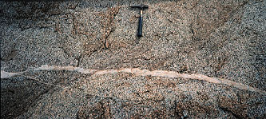
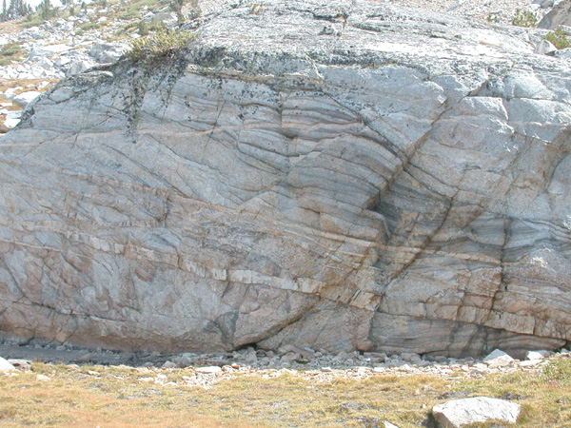
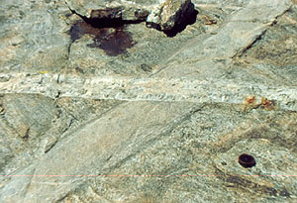
Aplite dikes

Slide 61
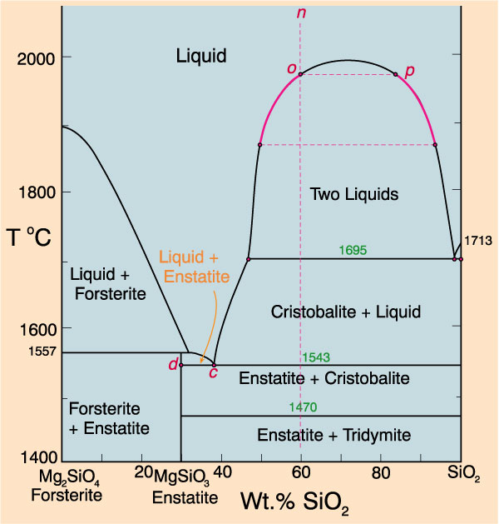
Liquid Immiscibility
Liquid immiscibility in the Fo-SiO₂ system
Figure 6.12. Isobaric T-X phase diagram of the system Fo-Silica at 0.1 MPa. After Bowen and Anderson (1914) and Grieg (1927). Amer. J. Sci.
Notes:
Several early geologists appealed to liquid immiscibility as a mechanism for magmatic differentiation
Might be responsible for the separation of a granitic liquid from an evolving system (presumably from an initial basaltic parent)
Liquid immiscibility in the Fo-SiO₂ system
Very limited compositional range
How behave as add more components?

Slide 62
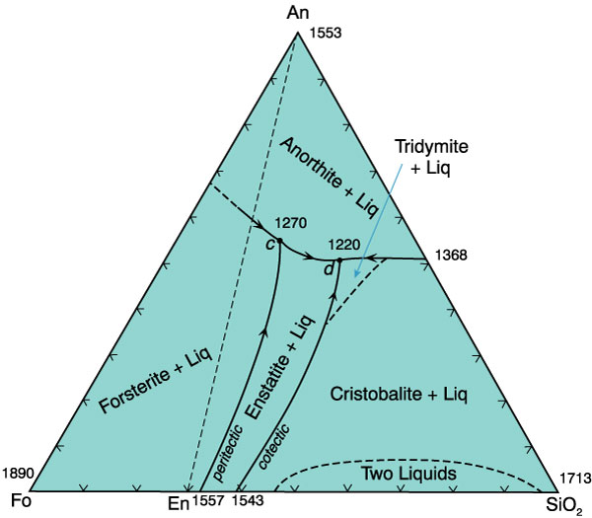
The effect of adding alkalis, alumina, etc. is to eliminate the solvus completely
Figure 7.4. Isobaric diagram illustrating the cotectic and peritectic curves in the system forsterite-anorthite-silica at 0.1 MPa. After Anderson (1915) A. J. Sci., and Irvine (1975) CIW Yearb. 74.
Notes:
Liquid immiscibility quickly dropped out of favor

Slide 63
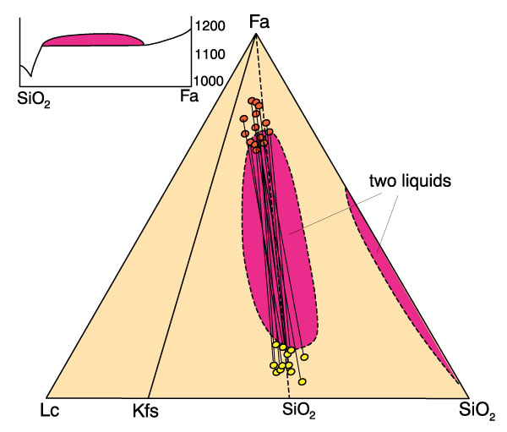
Renewed interest when Roedder (1951) discovered a second immiscibility gap in the iron-rich Fa-Lc-SiO₂ system
Figure 11-7. Two immiscibility gaps in the system fayalite-leucite-silica (after Roedder, 1979). Yoder (ed.), The Evolution of the Igneous Rocks. Princeton University Press. pp. 15-58. Projected into the simplified system are the compositions of natural immiscible silicate pair droplets from interstitial Fe-rich tholeiitic glasses (Philpotts, 1982). Contrib. Mineral. Petrol., 80, 201-218.
Notes:
Liquid immiscibility is now widely accepted as a phenomenon in natural magmas
But the extent of the process, and its importance in generating large bodies or a significant proportion of evolved magmatic rocks is still dubious

Slide 64
Some Examples
Late silica-rich immiscible droplets in Fe-rich tholeiitic basalts (as in Roedder)
Sulfide-silicate immiscibility (massive sulfide deposits)
Carbonatite-nephelinite systems (Chapter 19)
Notes:
Granites & rhyolites? Bimodal basalt-rhyolite? Unlikely, since don’t correspond to any known experimental gaps

Slide 65
Compositional Convection and In Situ Differentiation Processes
In-situ: crystals don’t sink/move
Typically involves
Diffusion
Convective separation of liquid and crystals
Notes:
Many rock suites are diversified in ways that cannot be adequately explained by classical partition/separation mechanisms
Propose alternative methods in which diversification takes place by in situ (in place) and/or convective processes within a liquid or liquid-solid boundary layer

Slide 66
The Soret Effect and Thermogravitational Diffusion
Thermal diffusion, or the Soret effect
Heavy elements/molecules migrate toward the colder end and lighter ones to the hotter end of the gradient
Notes:
Soret Effect:
A stagnant homogeneous binary solution, when subject to a strong temperature gradient, spontaneously develop a concentration gradient in the two components

Slide 67
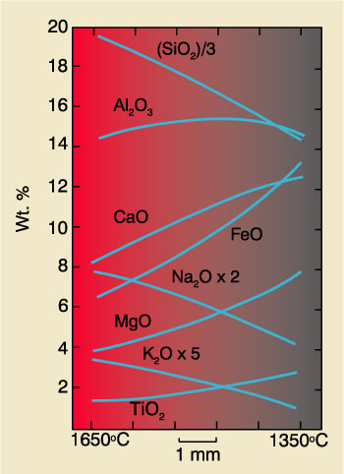
Walker and DeLong (1982) subjected two basalts to thermal gradients of nearly 50ºC/mm (!)
Found that:
Samples reached a steady state in a few days
Heavier elements → cooler end and the lighter → hot end
Figure 7.4. After Walker, D. C. and S. E. DeLong (1982). Contrib. Mineral. Petrol., 79, 231-240.
Notes:
Due to the extreme thermal gradients, it is unlikely that thermal diffusion is effective in natural systems
Natural thermal gradients are much smaller
Components must diffuse over greater distances
Diffusion is quite slow in silicate magmas so crystal settling and/or convection may stir up the delicate Soret gradients

Slide 68
Hildreth (1979) 0.7 Ma Bishop Tuff at Long Valley, California
Vertical compositional variation in the stratified tuff
Thermal gradient in chamber
Notes:
Vertical compositional variation in the stratified tuff
Correlates with variations in a compositionally stratified upper magma chamber that was progressively emptied from the top downward. Compositional gradient in chamber
Thermal gradient in chamber
Using mineral geothermometry Hildreth was able to demonstrate that the earliest eruptive materials, now at the base of the flow (but representing the top of the chamber) erupted at 720ºC, while the latest material (lower in the chamber) erupted at 780ºC

Slide 69
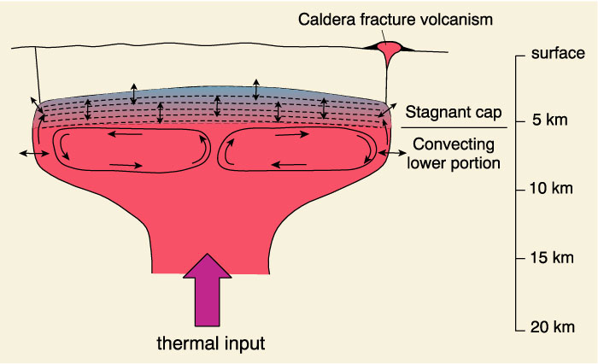
Model
Figure 11-11. Schematic section through a rhyolitic magma chamber undergoing convection-aided in-situ differentiation. After Hildreth (1979). Geol. Soc. Amer. Special Paper, 180, 43-75.
Notes:
The magma near the vertical contact becomes enriched in water from the wall rocks
Water-enriched boundary layer, although cooler, is less dense than the interior magma, and rises to concentrate near the top of the chamber
This is compositional convection
→ A growing density-stabilized boundary layer cap, which inhibits convection in that portion
→ Gradients in the cap rock, initially reflecting the water content, which, due to density differences, increases upward
So far it is quite likely
Hildreth then went on to propose Thermogravitational Diffusion
Volatile gradient affects structure of the melt and the degree of polymerization (Section 7.4.1), and thus O/(Si+Al) in the liquid
T, volatile, and O/(Si + Al) gradients → diffusion in the cap → vertical compositional gradients in the other components
Hildreth’s stratigraphic enrichments do not correlate well with the thermal Soret gradients
Thermogravitational diffusion no longer in vogue, but a number of in situ processes are possible, including the first parts of Hildreth’s scheme

Slide 70
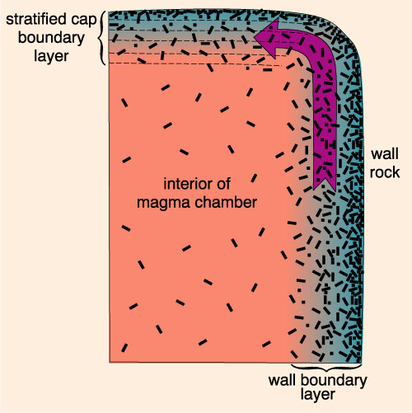
Langmuir Model
Thermal gradient at wall and cap → variation in % crystallized
Compositional convection → evolved magmas from boundary layer to cap (or mix into interior)
Figure 11.12 Formation of boundary layers along the walls and top of a magma chamber. From Winter (2001) An Introduction to Igneous and Metamorphic Petrology. Prentice Hall
Notes:
Thermal gradient at wall and cap → variation in % crystallized from ~100% at margin to ~0% in the interior
Compositional convection can introduce evolved magmas from boundary layer to cap (or mix into interior)
This is a lot like Hildreth’s model, but does not involve volatiles

Slide 71
Magma Mixing
End member mixing for a suite of rocks
Variation on Harker-type diagrams should lie on a straight line between the two most extreme compositions
Notes:
A bit like liquid immiscibility in reverse
Early notion that basalt and rhyolite were the two main primitive magmas
The intermediate magmas were created by mixing these two in various proportions
But the variety of natural magmas is much broader than can be attained by the mixing of two end members
End-member mixing:
Variation in each element or oxide on Harker-type diagrams should lie on a straight line between the values representing the two most extreme compositions (presumably representing the two parental magmas)
Nearly all volcanic suites have a number of curved lines that we can explain by multiphase fractional crystallization, but not as easily by binary end member mixing

Slide 72
Figure 11.2 Variation diagram using MgO as the abscissa for lavas associated with the 1959 Kilauea eruption in Hawaii. After Murata and Richter, 1966 (as modified by Best, 1982)
Notes:
In the rare cases for which the variation diagrams do form linear patterns, the cause could be either
1) magma mixing or
2) fractional xlliz of a single phase
Usually textural or field evidence will differentiate between the two possibilities
In the case of Fig. 11-2 the guilty perpetrators, the olivine phenocrysts, are easily observed

Slide 73
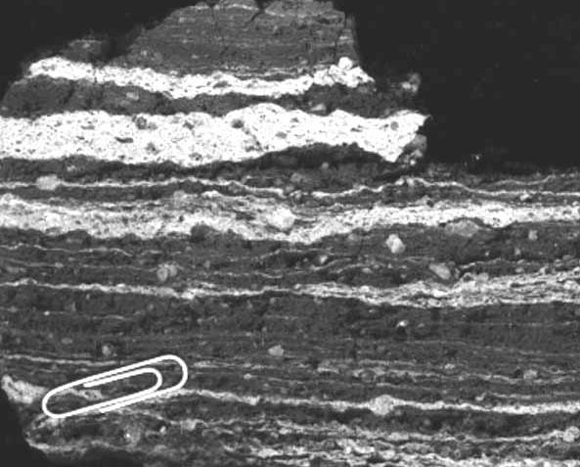
Comingled basalt-Rhyolite Mt. McLoughlin, Oregon
Figure 11.8 From Winter (2001) An Introduction to Igneous and Metamorphic Petrology. Prentice Hall
Basalt pillows accumulating at the bottom of a in granitic magma chamber, Vinalhaven Island, Maine
Notes:
Magma mixing does not receive as much attention as it should - there is ample evidence for the process taking place
It is most evident in cases in which the magmas are quite different, such as basalts and intermediate or silicic types
Due to the large differences in the physical properties of the contrasting magmas, the degree of mixing of these comingled magmas is usually not extensive
Swirls of contrasting colors on the hand sample or outcrop scale, or even as intimate mixtures of glass in thin section
Basaltic component at higher temperature, so comingling with silicic magma will chill the basalt and superheat the silicic
Common disequilibrium assemblages
plagioclase or pyroxenes of radically different compositions
juxtaposed olivine and quartz
corroded and partially resorbed phenocrysts

Slide 74
Assimilation
Incorporation of wall rocks (diffusion, xenoliths)
Assimilation by melting is limited by the heat available in the magma
Notes:
Assimilation by melting is limited by the heat available in the magma
Wall rock must first be heated to the melting point, and then at least partially melted in order to be assimilated, and this heat must be supplied by the magma itself
Theoretically possible for a magma to assimilate 40% of its weight in country rock
But the crystallized portion of the magma at the cool walls will form a barrier to inhibit further exchange
Assimilated components must then diffuse through the barrier
Diffusion of heat is much faster that diffusion of mass, so the magma will probably solidify before appreciable assimilation has occurred

Slide 75
Mixed Processes
May be more than coincidence: two processes may operate in conjunction (cooperation?)
AFC: FX supplies the necessary heat for assimilation
Fractional crystallization + recharge of more primitive magma
Notes:
Two or more processes may work simultaneously or in sequence during the generation, migration, and solidification of magmatic systems
Thus a number of magmas (and the resulting rocks) may be complex hybrids reflecting the combined effects of the various processes
May be more than coincidence: two processes may operate in conjunction (cooperation?)
AFC:
Combination of assimilation and fractional crystallization required
FX supplies the necessary heat for assimilation as proposed earlier
Fractional crystallization + recharge of more primitive magma
One approach: devise mathematical models for the behavior of certain trace elements and isotopes (or ratios) that are based on a combination of processes

Slide 76
Tectonic-Igneous Associations

